Slide 1
Speech Emotion Recognition
Enhancing Model Effectiveness and Uncovering Multi-Dimensional Use Cases
Group 1 - Bala Chikkala | Sujit Murahari Giridharan | Sai Koushik Valluri | Ratna Srikar Duriseti | Naga Suchandra Tirumalasetti

Slide 2
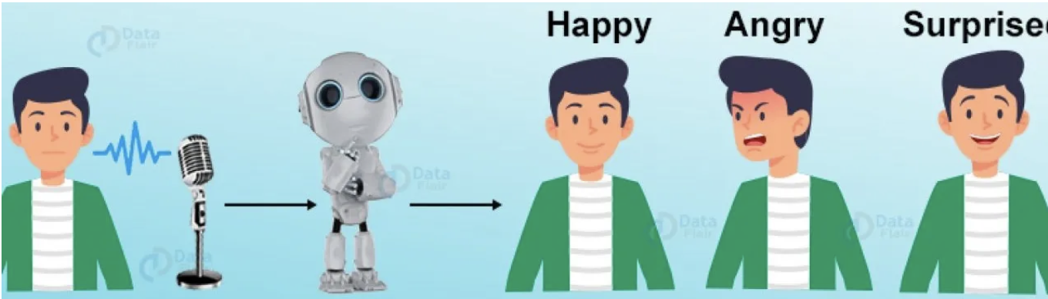
Introduction
Speech Emotion Recognition (SER) analyzes voice signals to detect human emotions, impacting AI, NLP, and Large Language Models.
Its applications range from healthcare to customer satisfaction analysis, aiding in identifying mental health issues and gauging sentiment.

Slide 3
Problem?
The main objective of this project is to detect human emotions through speech.
Speech Emotion Recognition has become increasingly popular recently due to its wide-ranging applications in healthcare, personnel management, education, and other fields.

Slide 4
Objective
We'll employ CNN models to develop a classification system, leveraging MFCCs derived from spectrogram data in diverse formats.
Through experimentation with various multi-layered architectures, we aim to identify the optimal model for accurately discerning human emotions.

Slide 5
CREMA-D: Contains 7,442 clips from 91 actors, encompassing a diverse range of genders, ages, and races, expressing six emotions at four intensity levels.
RAVDESS: Consists of 1,440 files from 24 professional actors, with each actor vocalizing various emotions at two intensity levels, providing a comprehensive dataset for emotion recognition research.
Dataset

Slide 6
Dataset
SAVEE: Developed with the assistance of four native English speakers, this dataset includes 480 audio samples portraying seven emotions, with each emotion represented by 15 sentences, including common and distinct expressions.
TESS: Comprising recordings from two actresses, this dataset features 2,800 audio files of 200 target words spoken with different emotions, offering a structured organization of emotions within folders for efficient analysis.

Slide 7
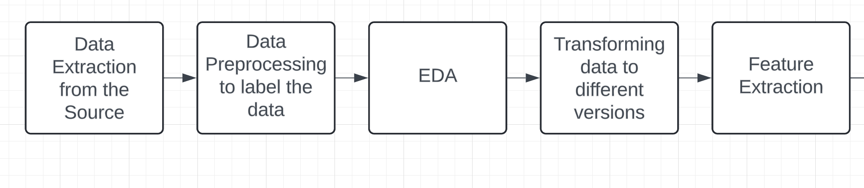
Methodology – Data Transformation & Preprocessing

Slide 8
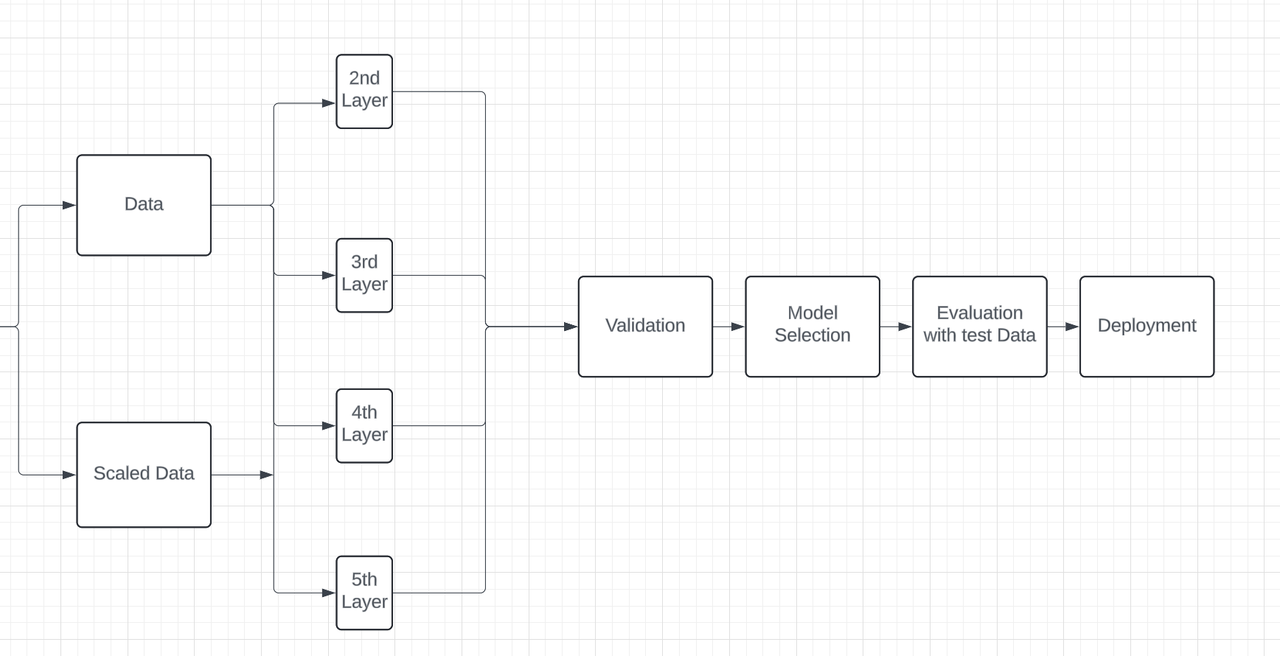
Methodology – Model building

Slide 9
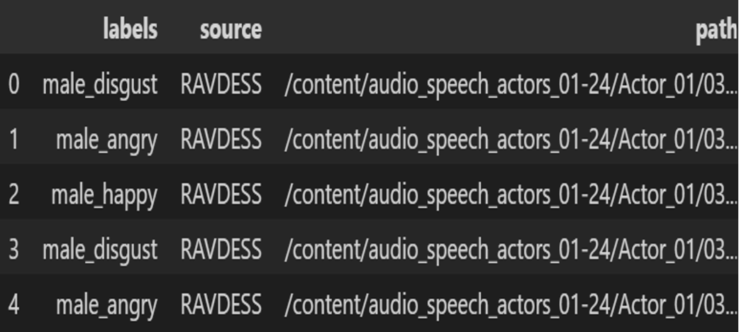
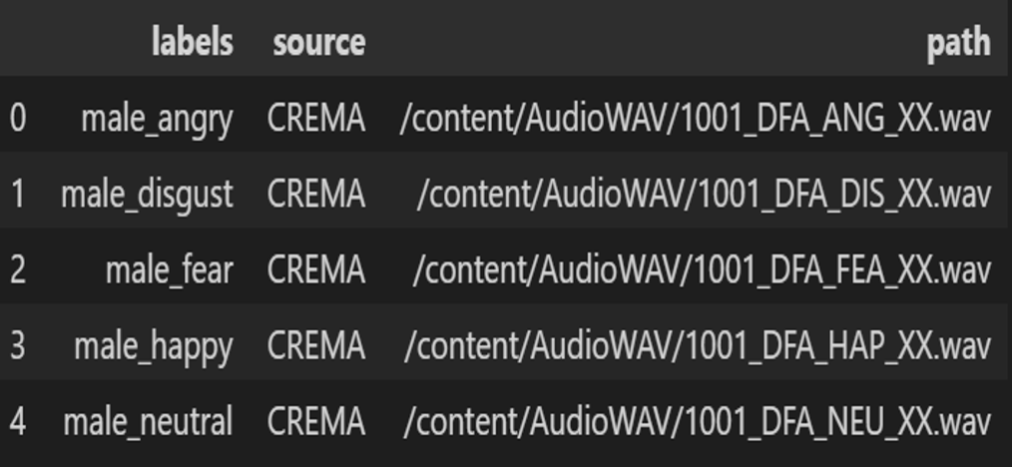
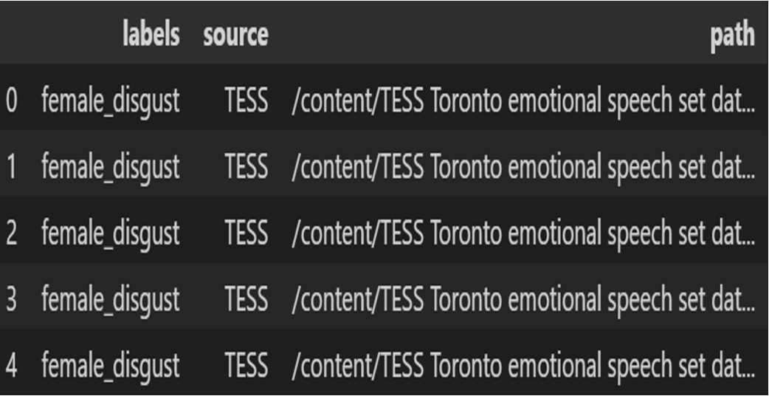
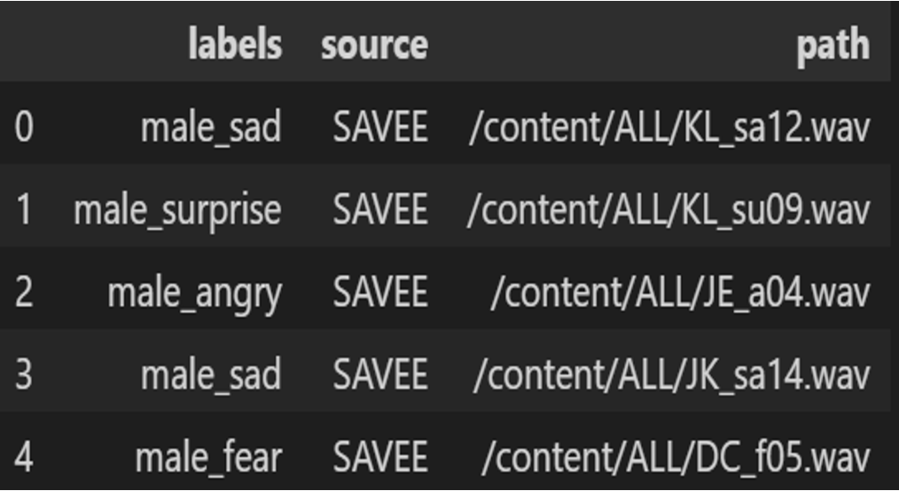
Data Preprocessing
• Each observation in the dataset was assigned a label based on the accompanying data descriptions, ensuring individual categorization.
• Following this labeling process, all four datasets were amalgamated into a single comprehensive dataset, facilitating unified analysis and model training.
RAVDESS
CREMA
TESS
SAVEE

Slide 10
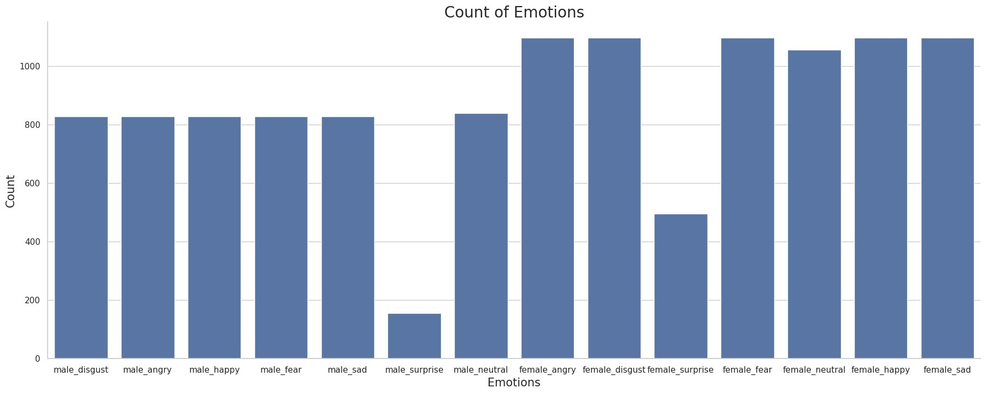
EDA- Emotion Count
The bar graph indicates that females tend to experience emotions such as anger, disgust, fear, happiness, and sadness more often, whereas surprise is the least frequently experienced emotion among males.

Slide 11
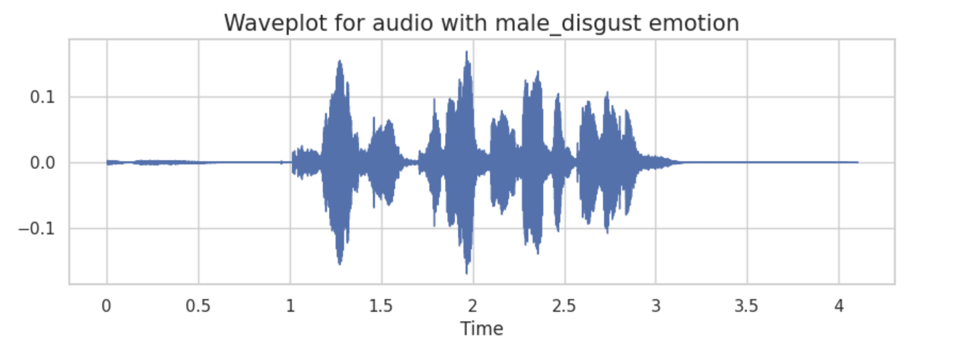
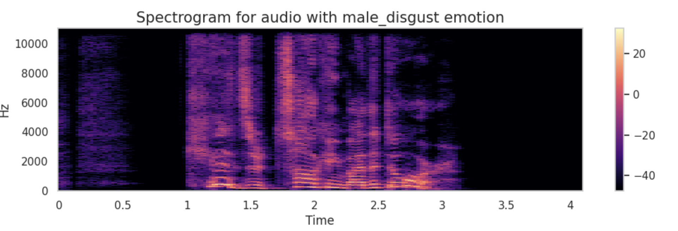
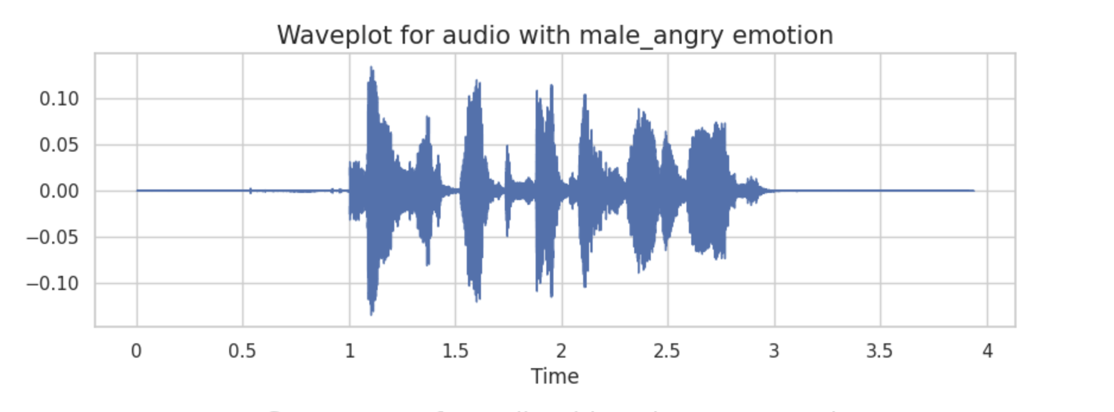
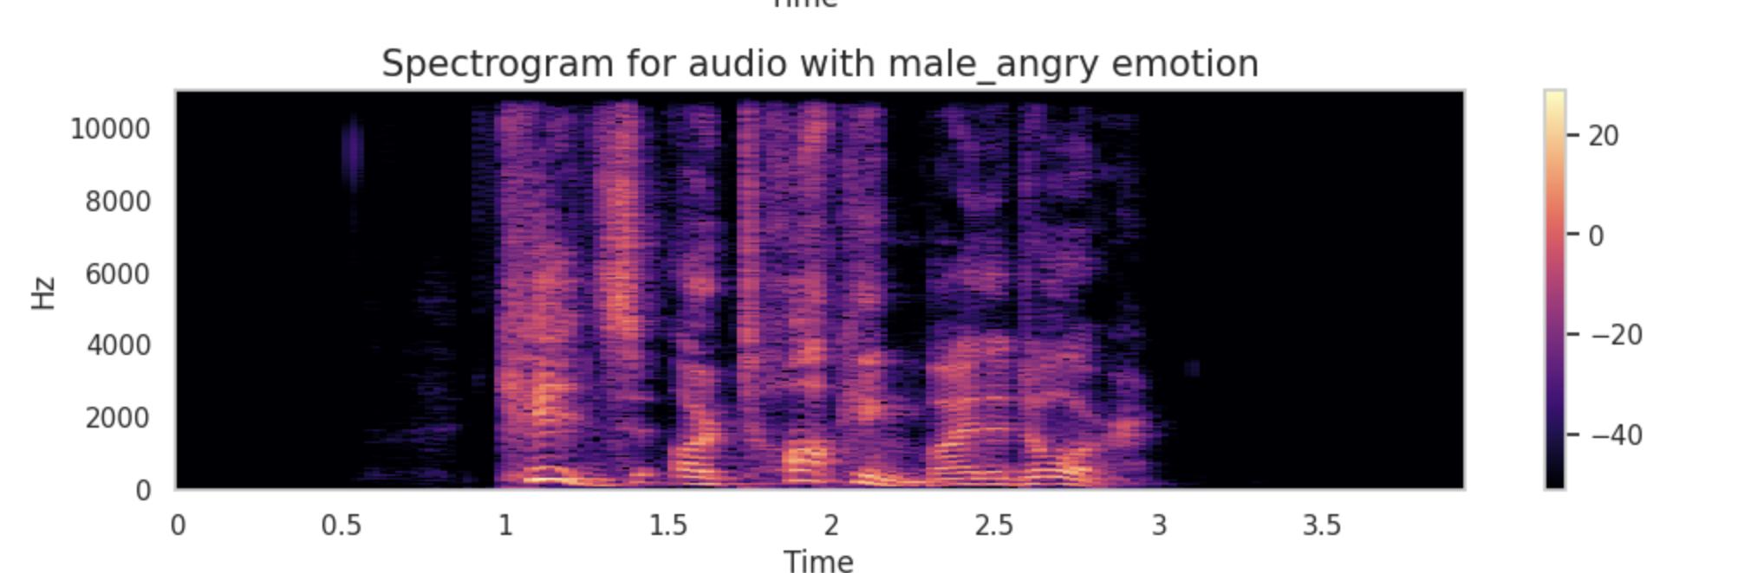
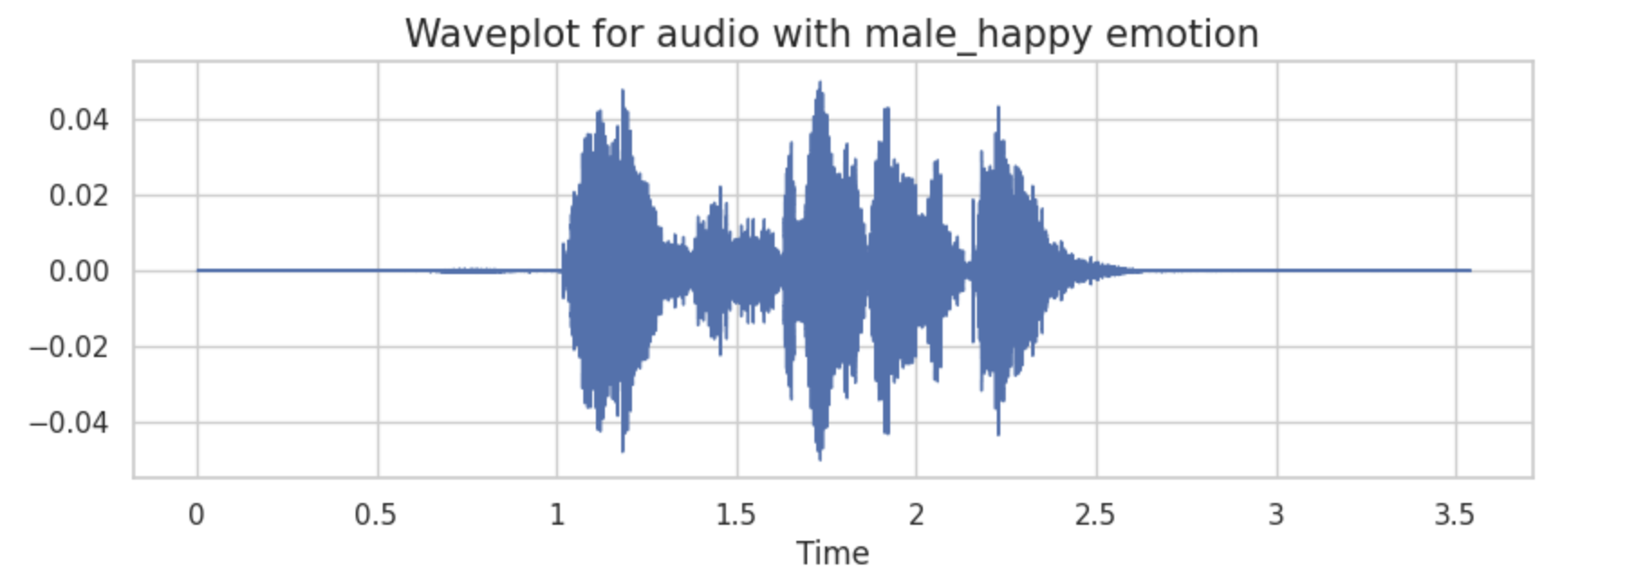
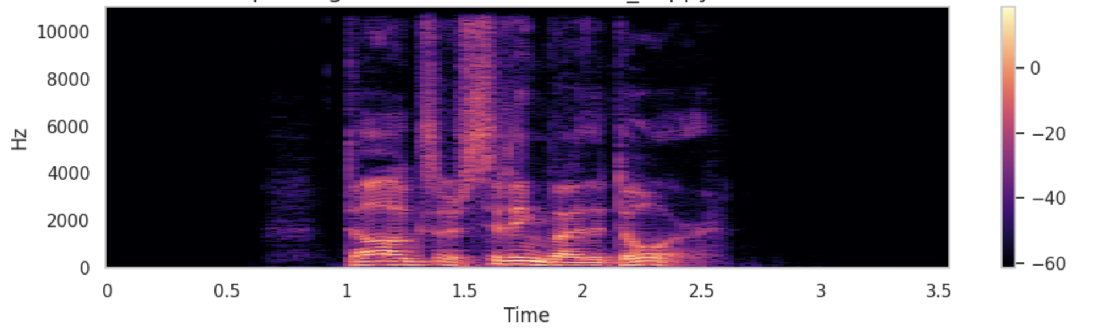
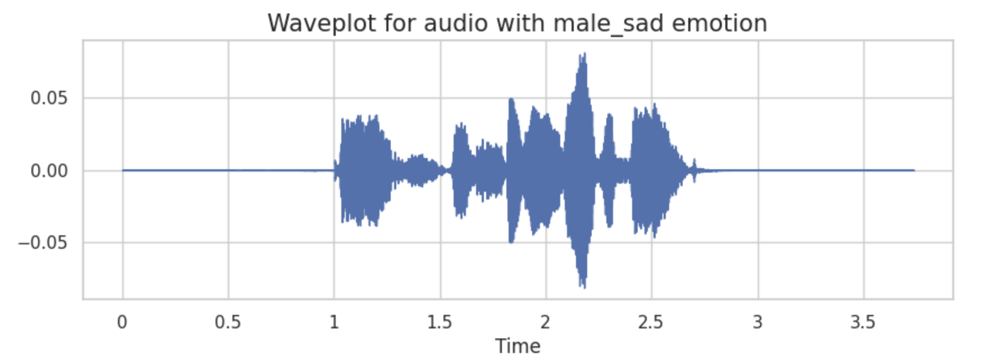
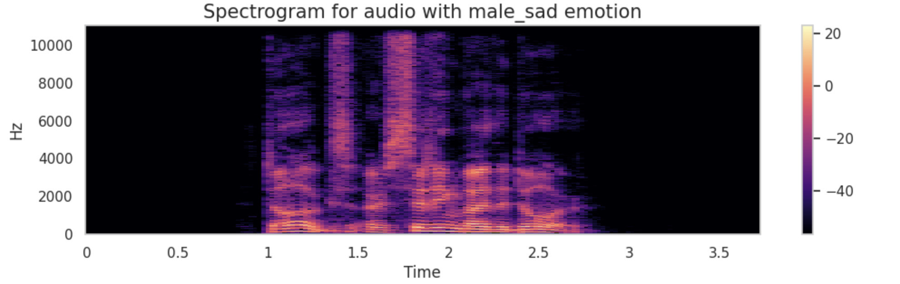
EDA- Waveform and spectrogram - Male

Slide 12
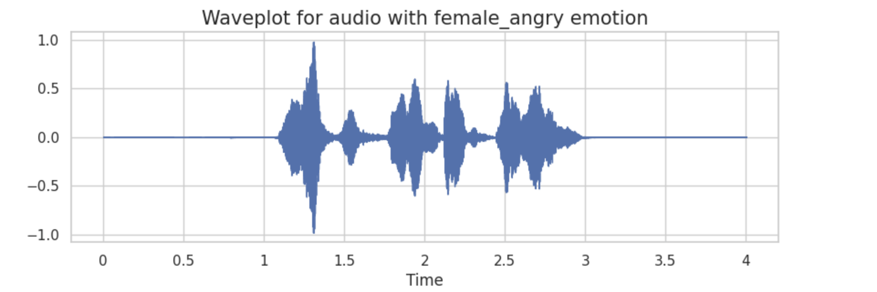
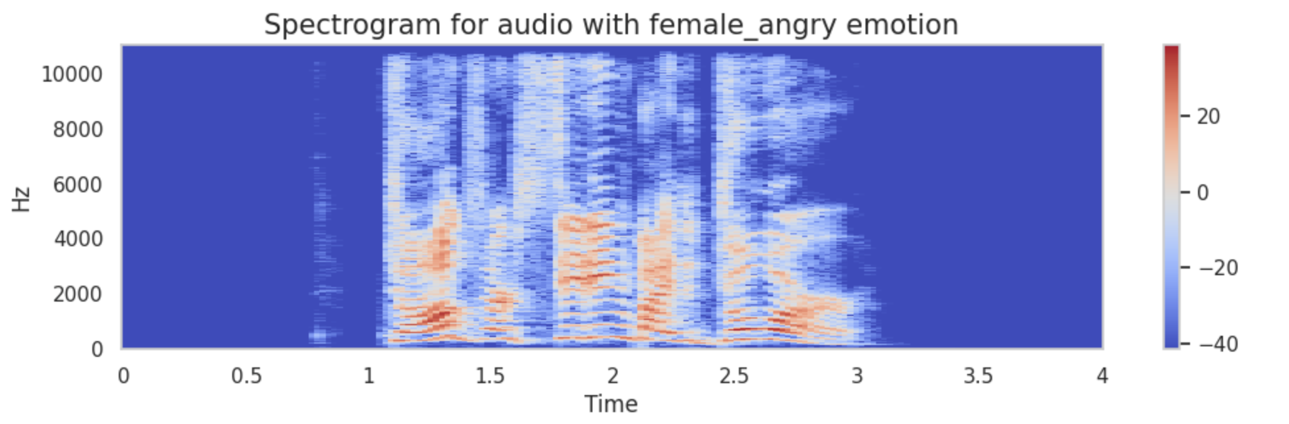
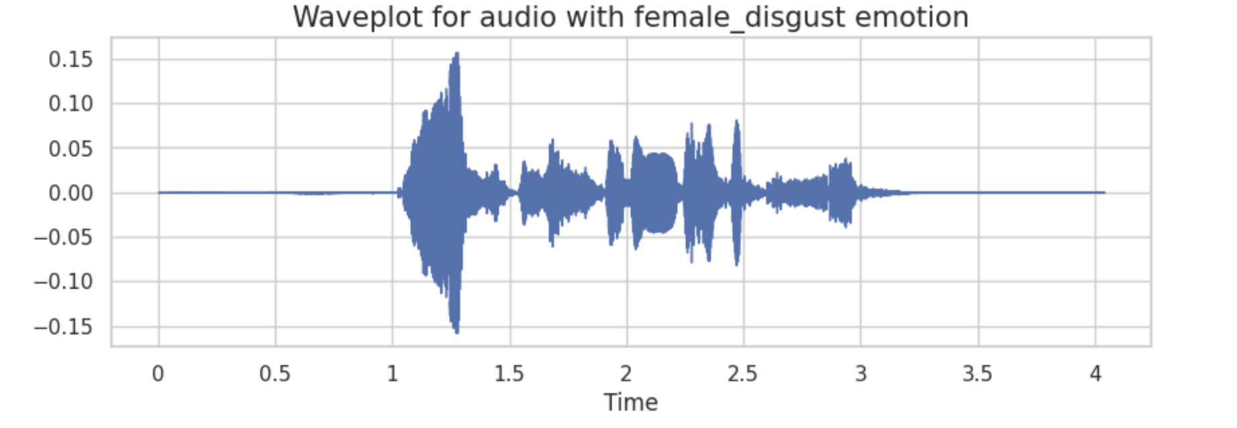
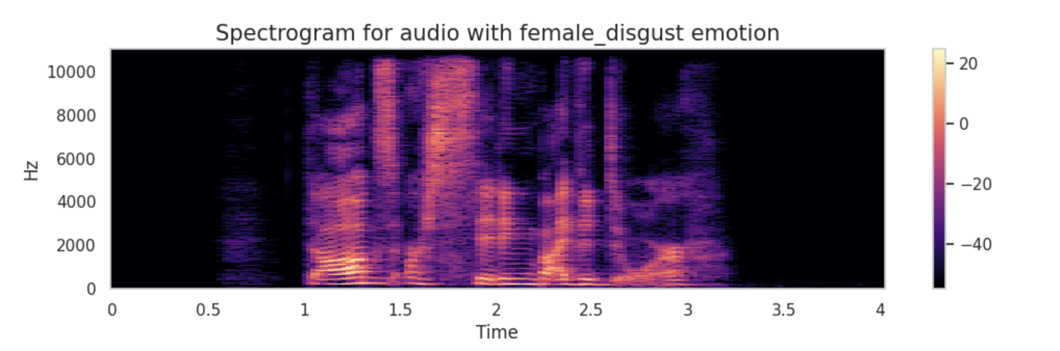
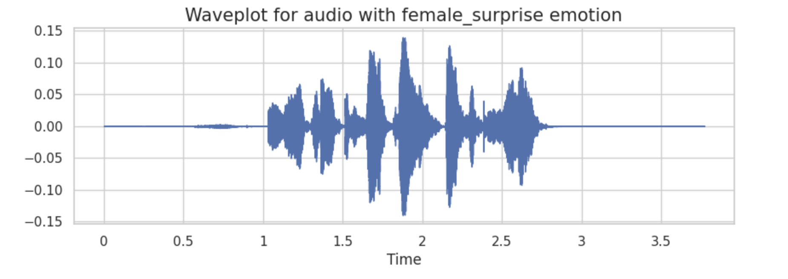
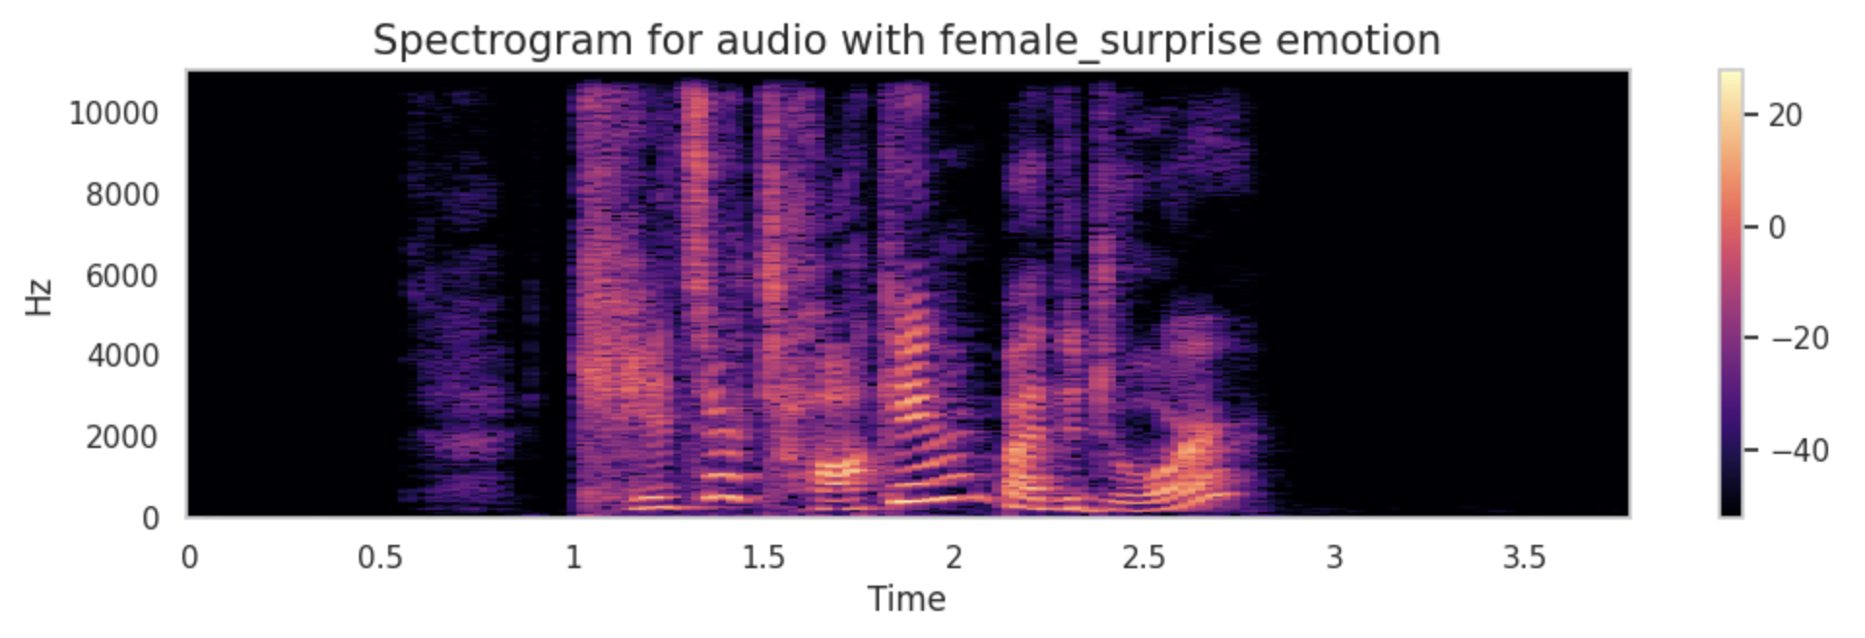
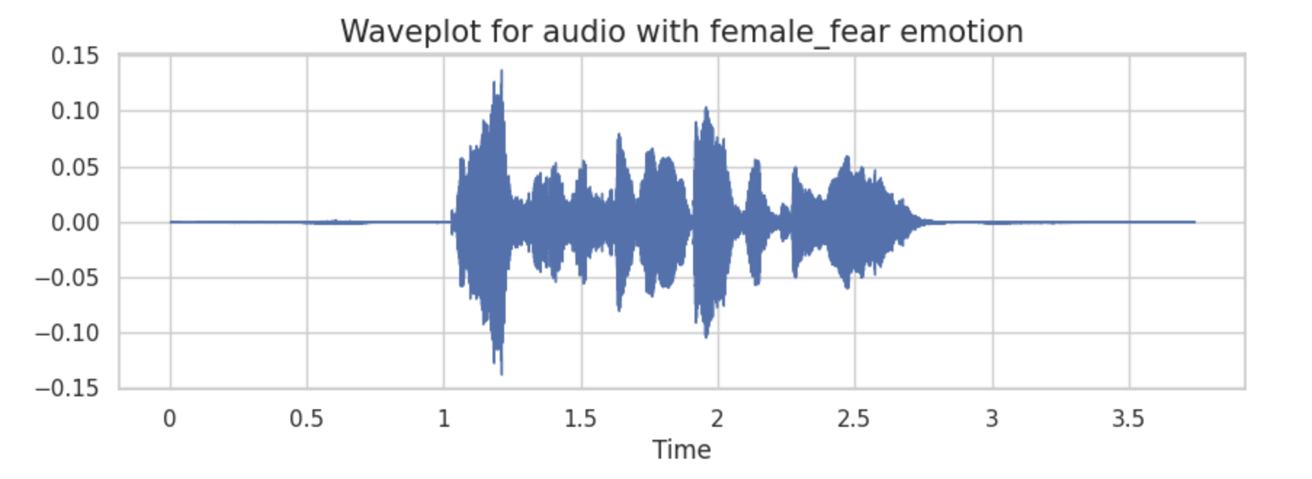
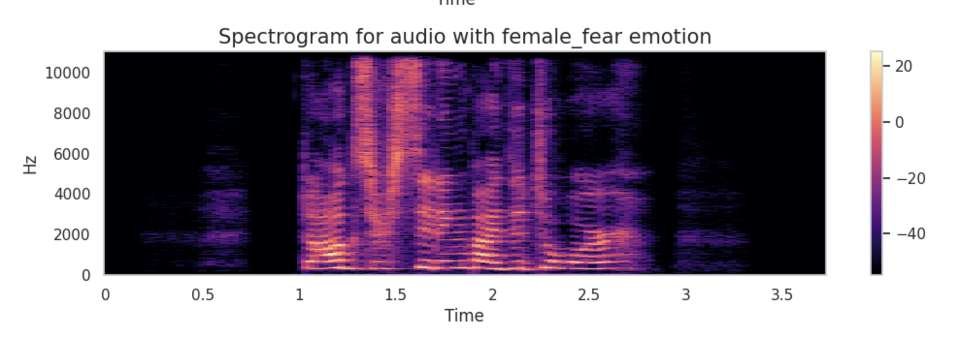
EDA- Waveform and spectrogram - Female

Slide 13
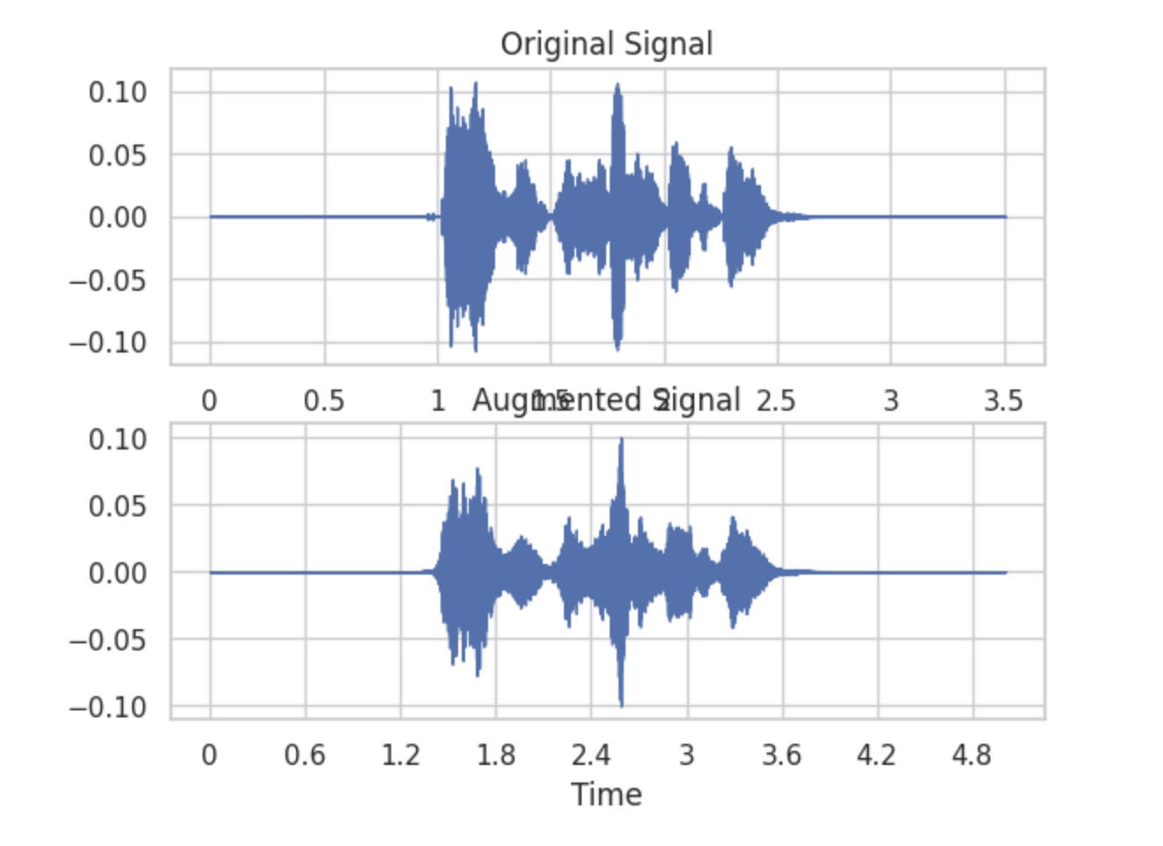
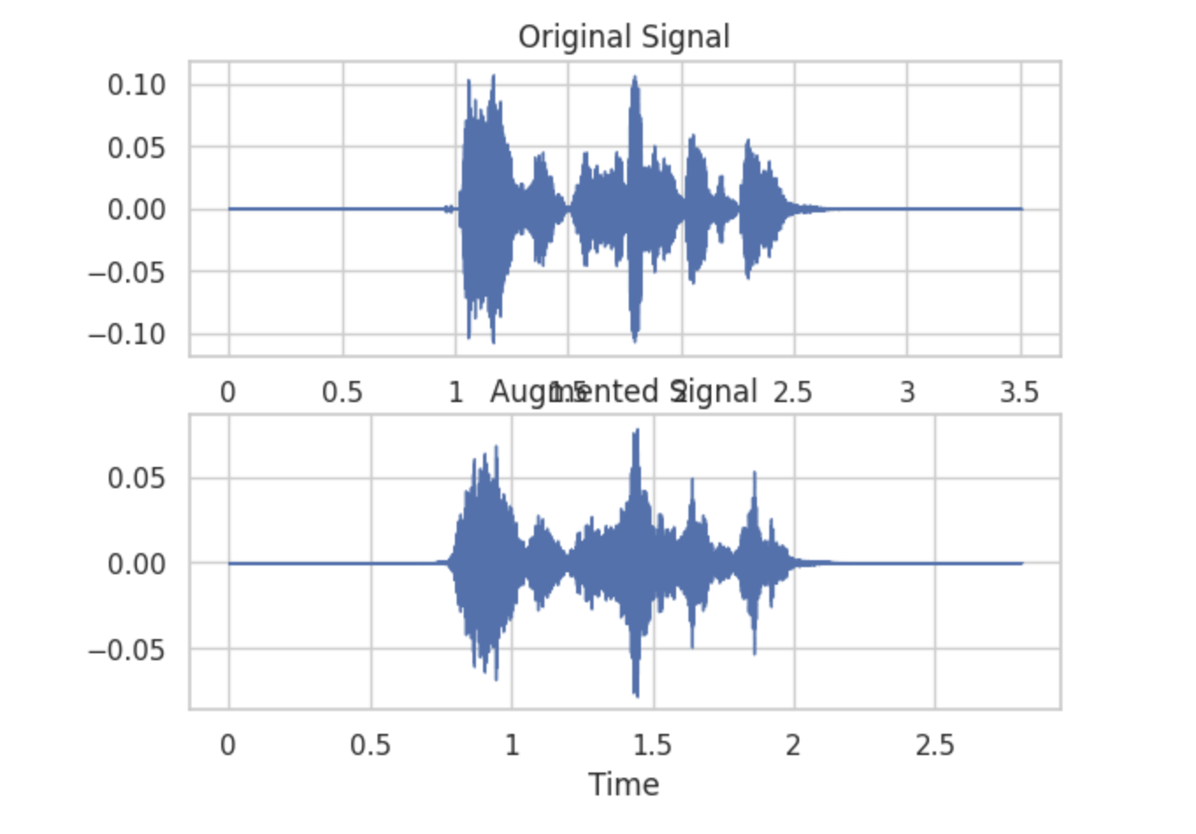
Data Transformation
Every audio file in the dataset has undergone various transformations, including alterations in noise levels, stretching, shifting, pitch adjustments, and changes in playback speed.
Stretch
Higher Speed

Slide 14
Feature Extraction
To all the transformations we extracted MFCC
What is MFCC? Why MFCC?
- ‘’MFCC (Mel-Frequency Cepstral Coefficients) is a feature extraction technique widely used in speech and audio signal processing. It mimics human auditory perception, converting audio signals into a compact representation suitable for tasks like speech recognition and speaker identification.’’
-MFCC focus on features of the audio signals which are significant for human speech perception and they also discard less relevant information

Slide 15
Balancing & Scaling
As observed in the EDA the male and female surprise are significantly small compared to the other emotions.
This may induce biased to the model so we are balancing the dataset where we use SMOTE algorithm from IMBLERAN
Now we have 7672 observations for each class in our target variable.
We also did one hot encoding on the target variable
We created a new Dataset which contains the scaled data to provide it as input and check the performance.

Slide 16
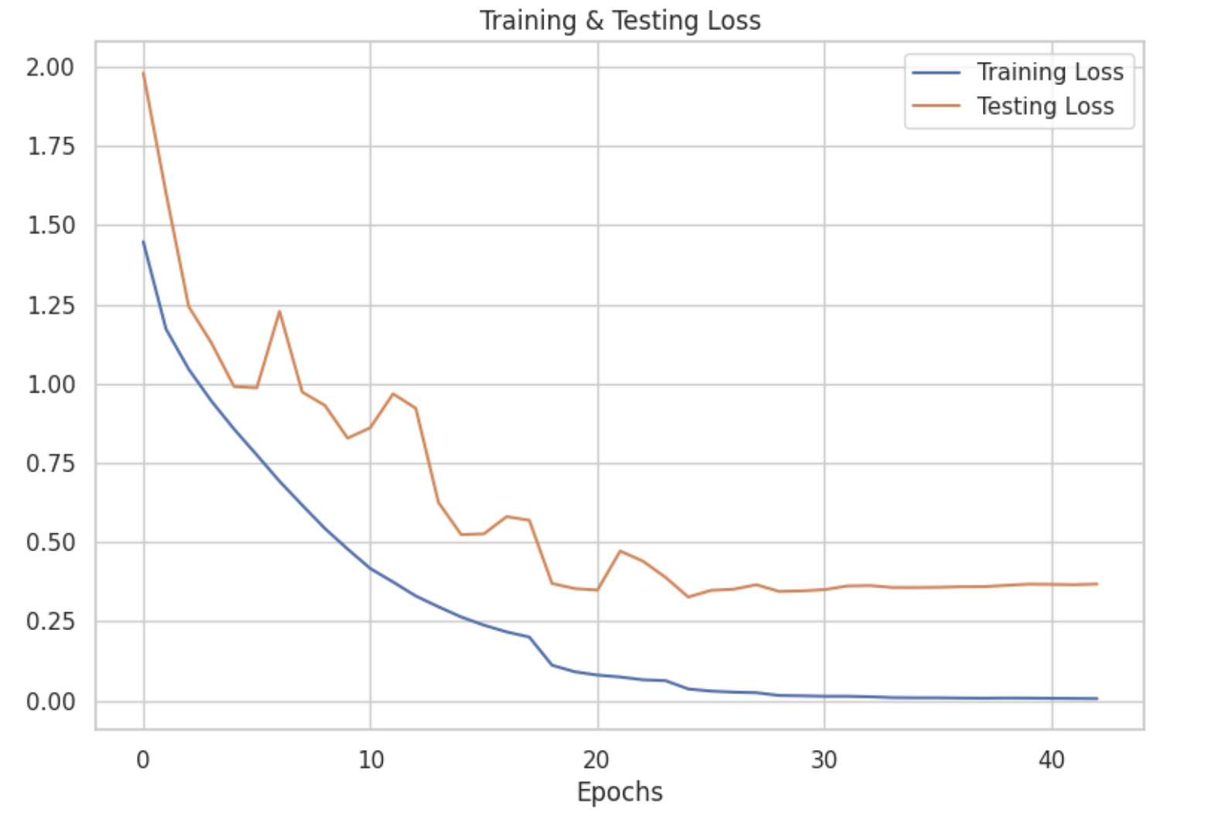
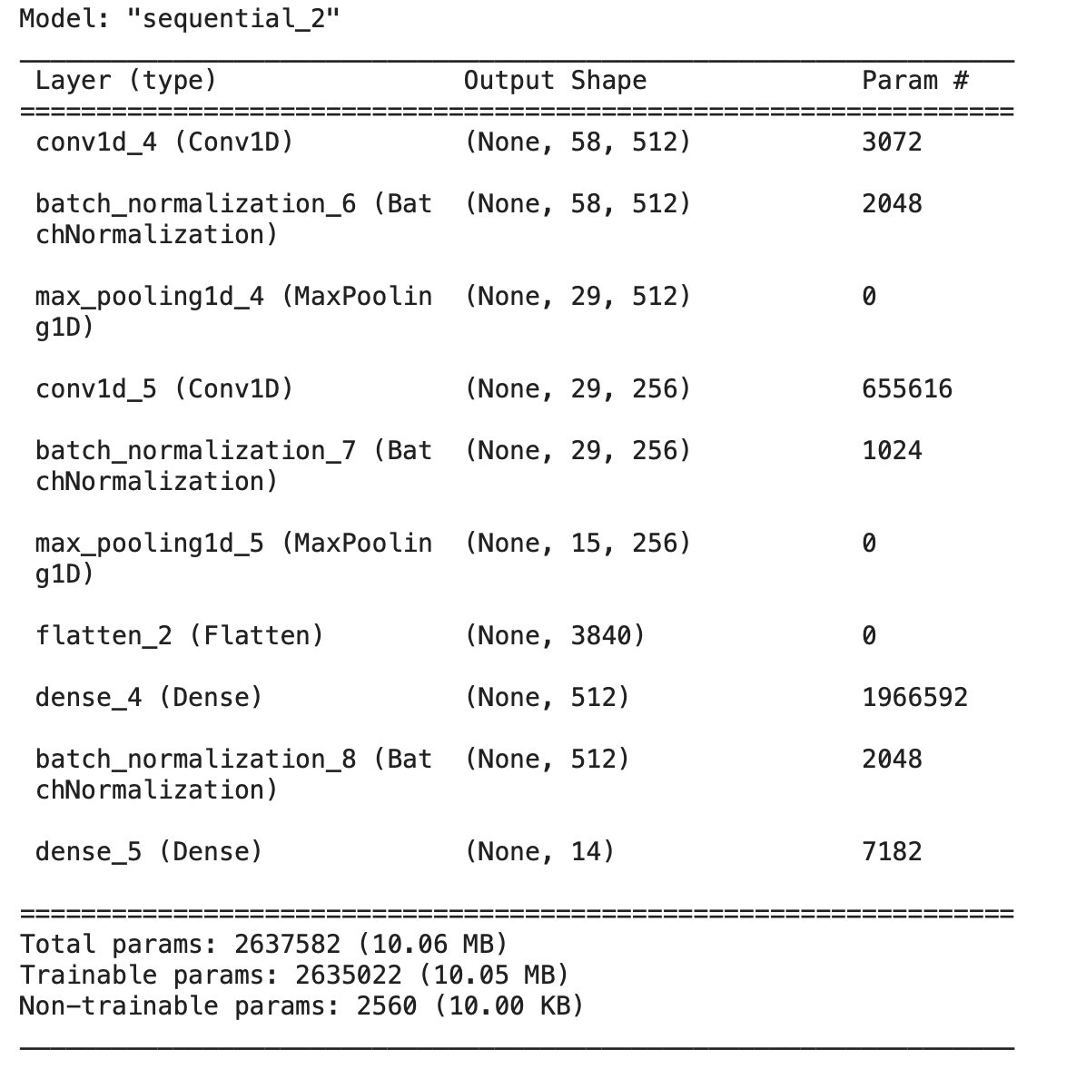
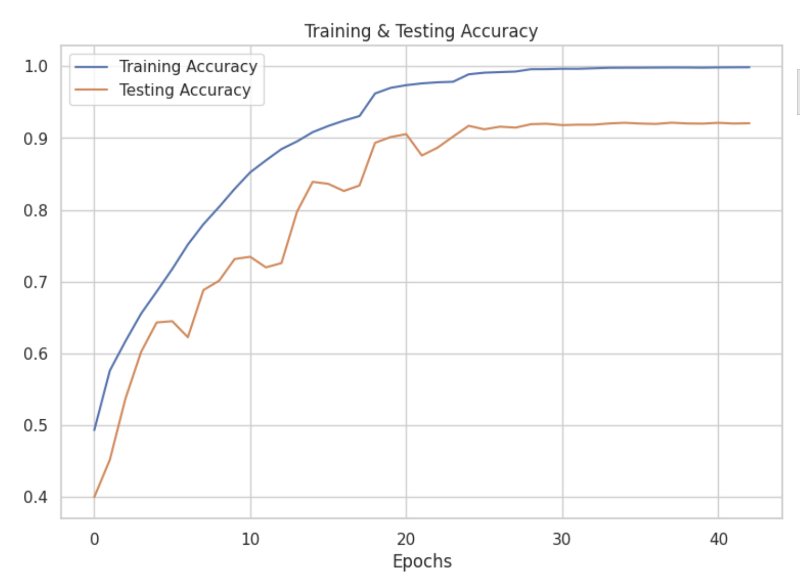
Model Building - 2 Layer

Slide 17
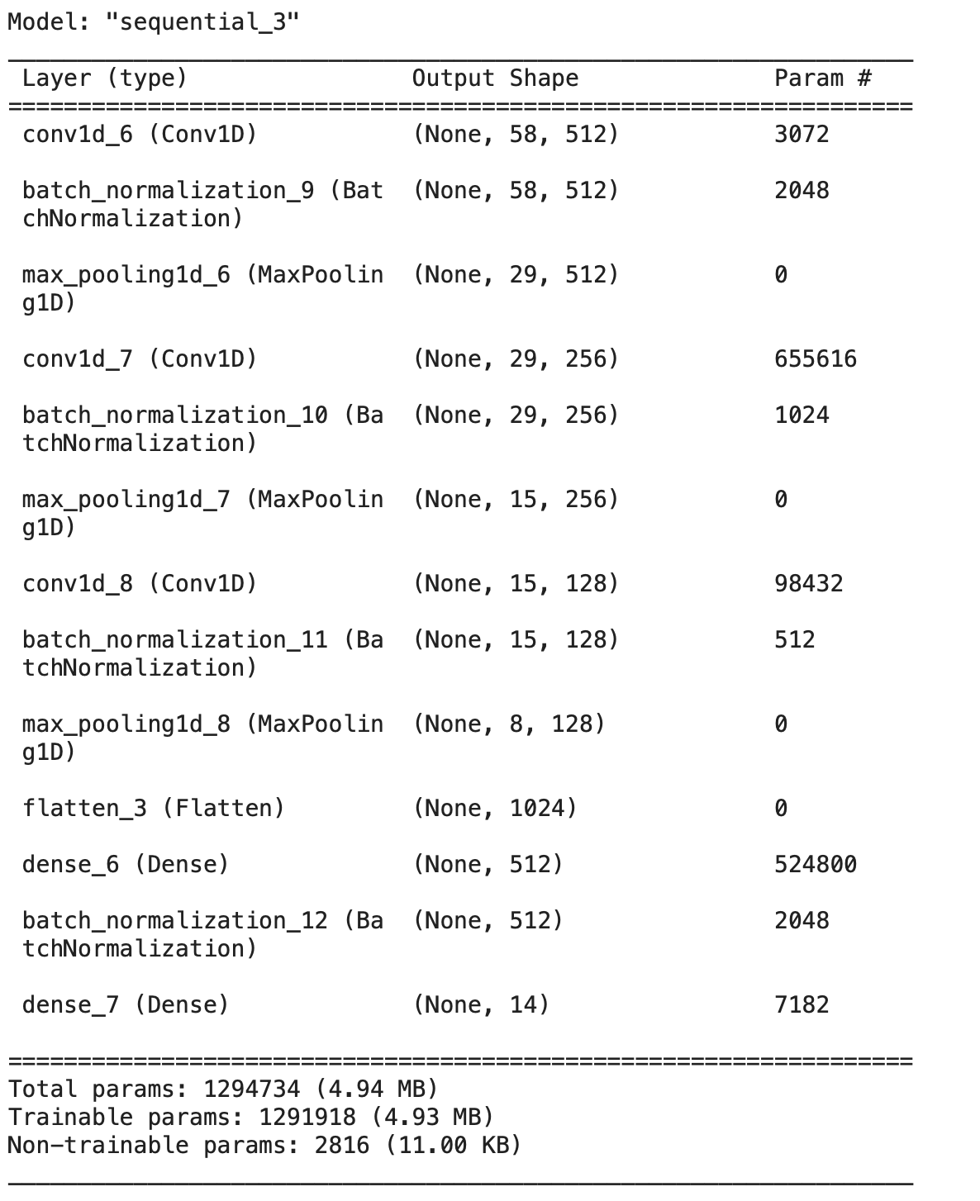
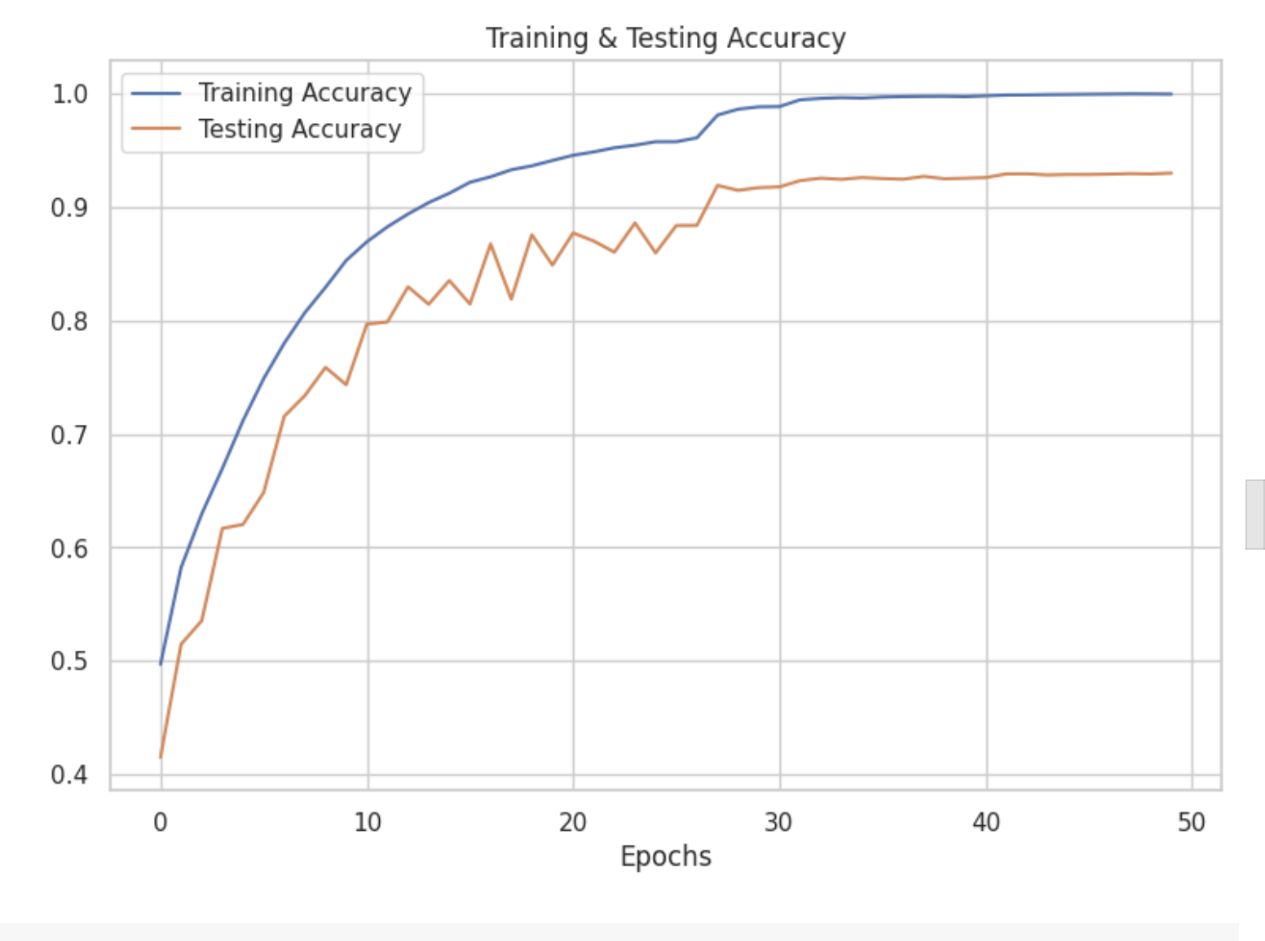
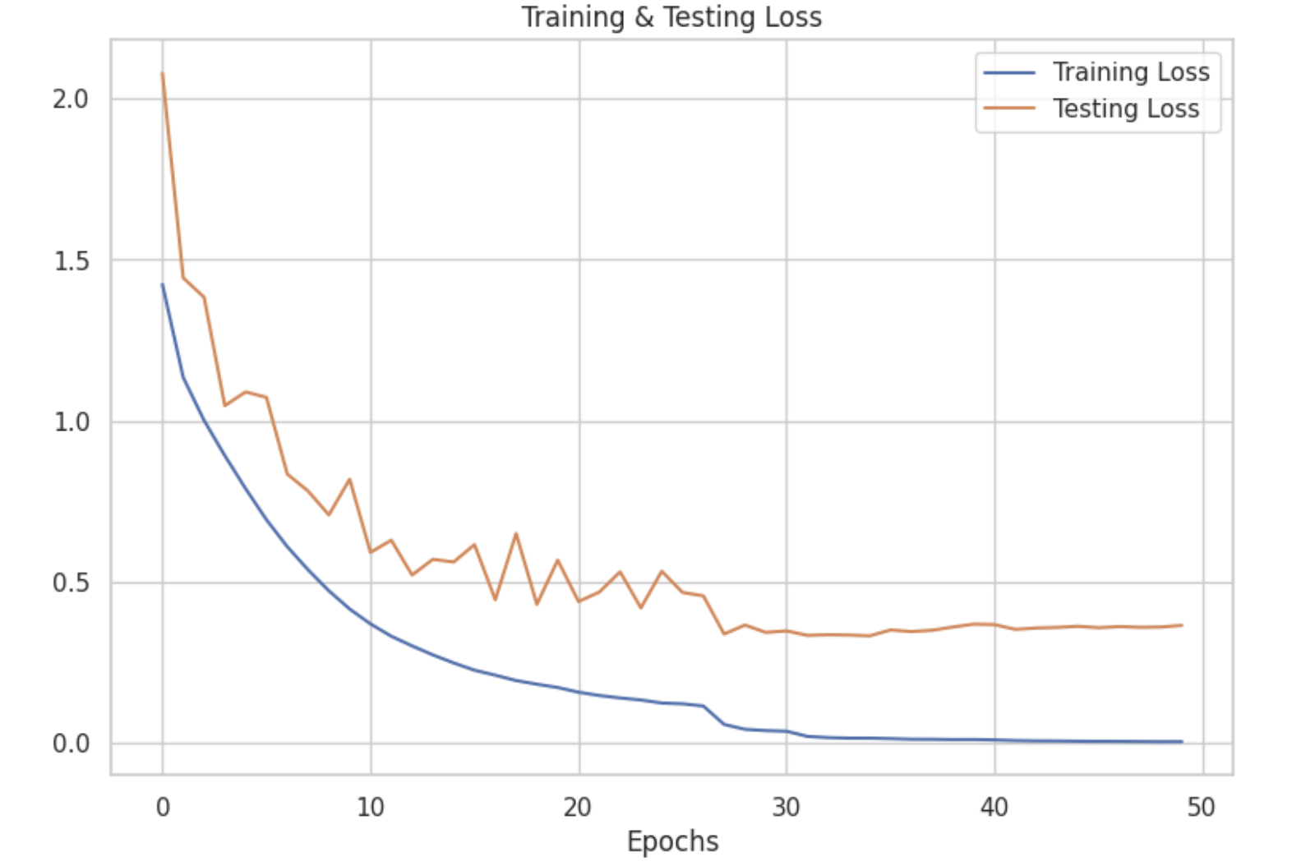
Model Building - 3 Layer

Slide 18
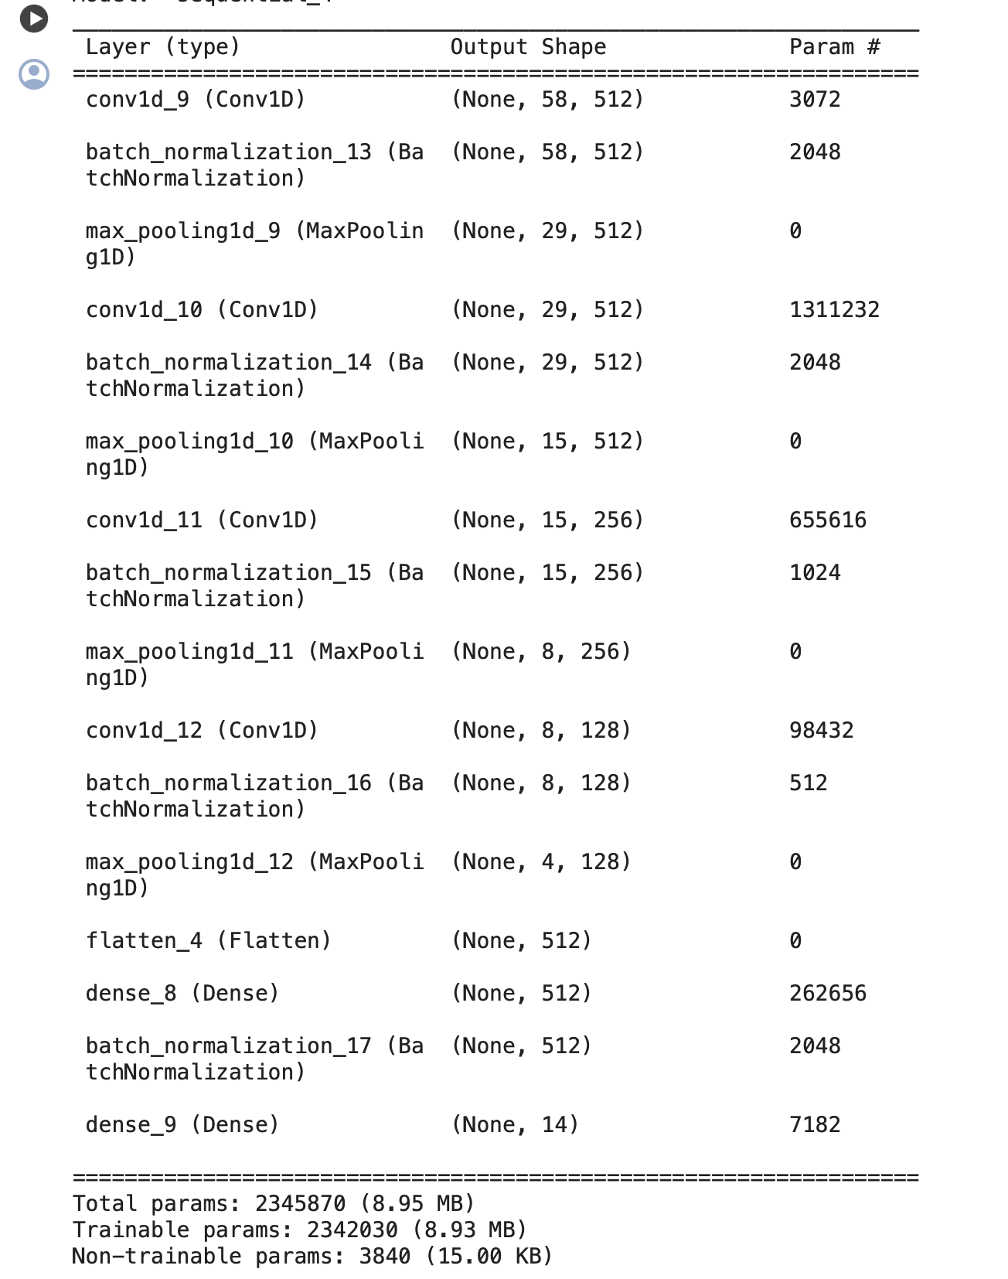
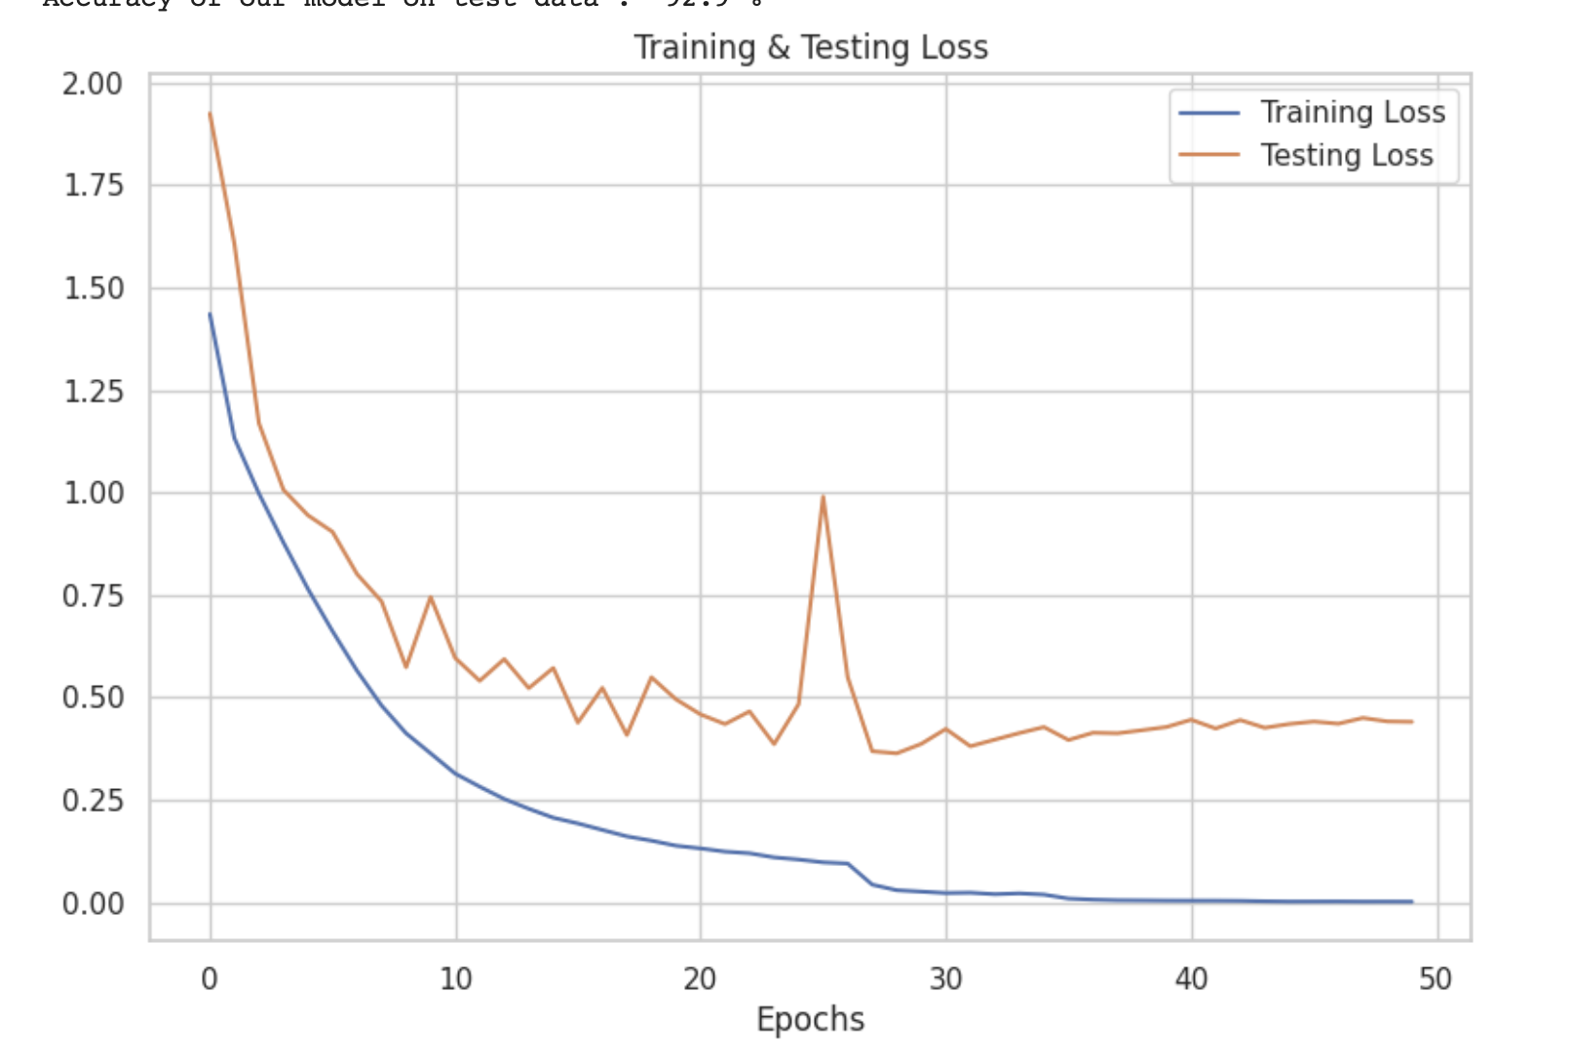
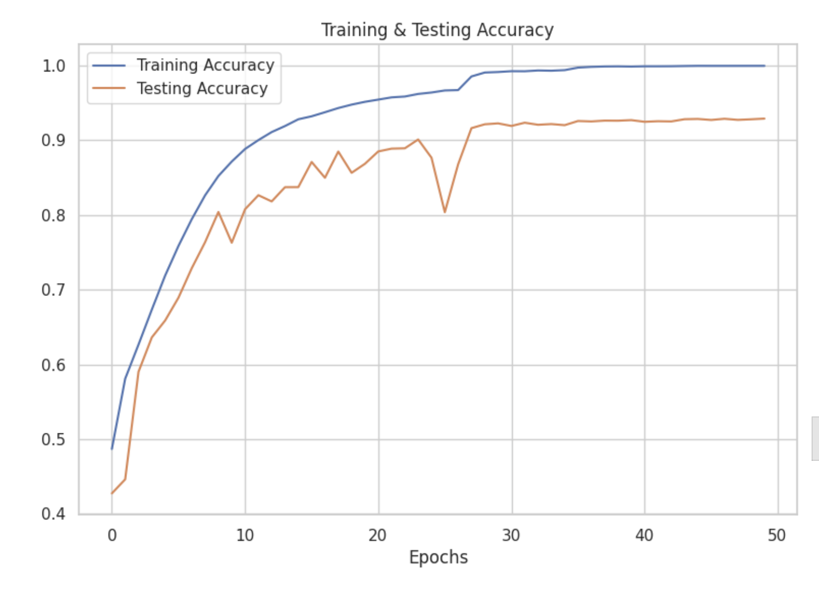
Model Building - 4 Layer

Slide 19
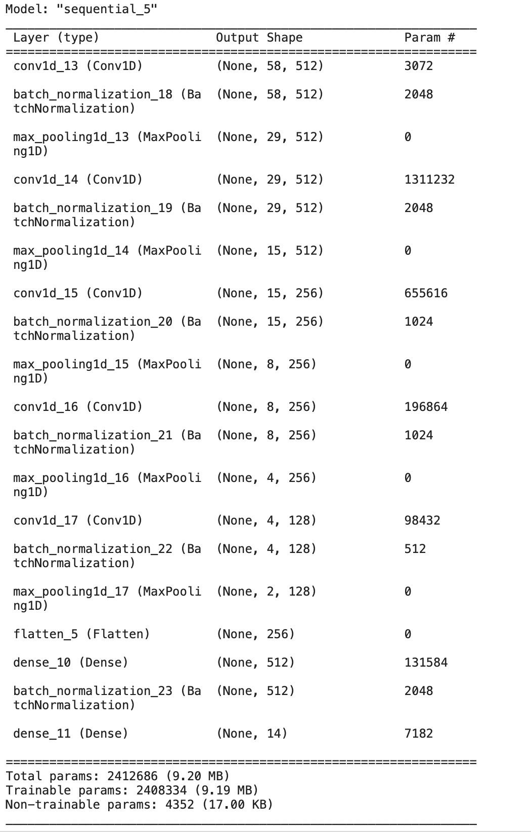
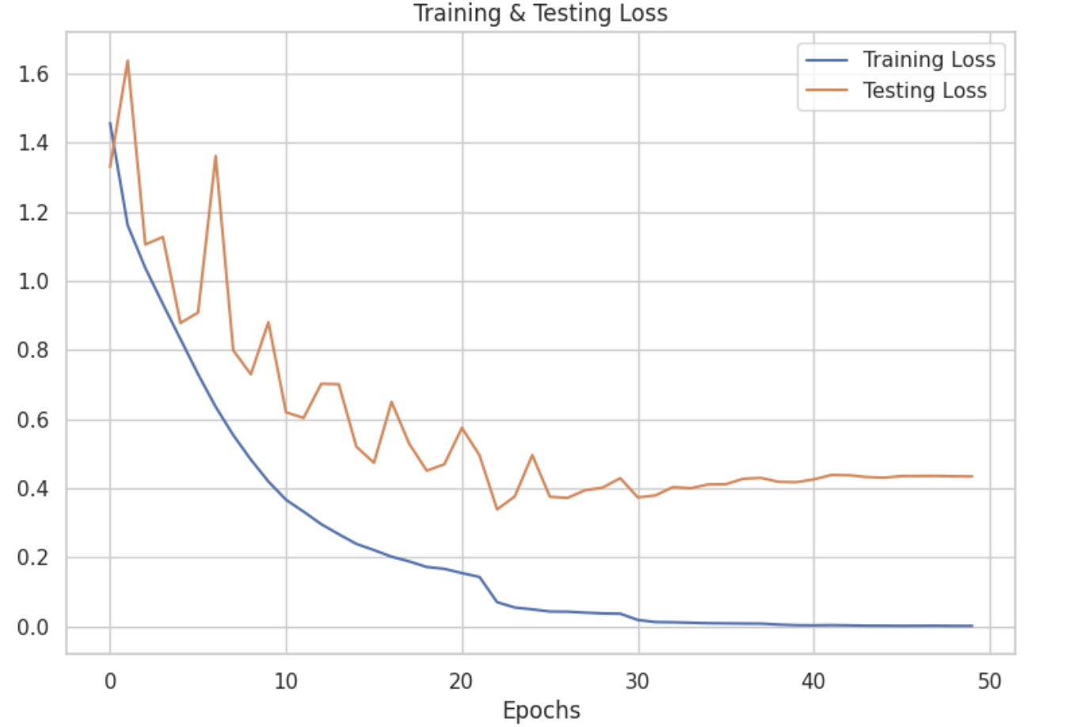
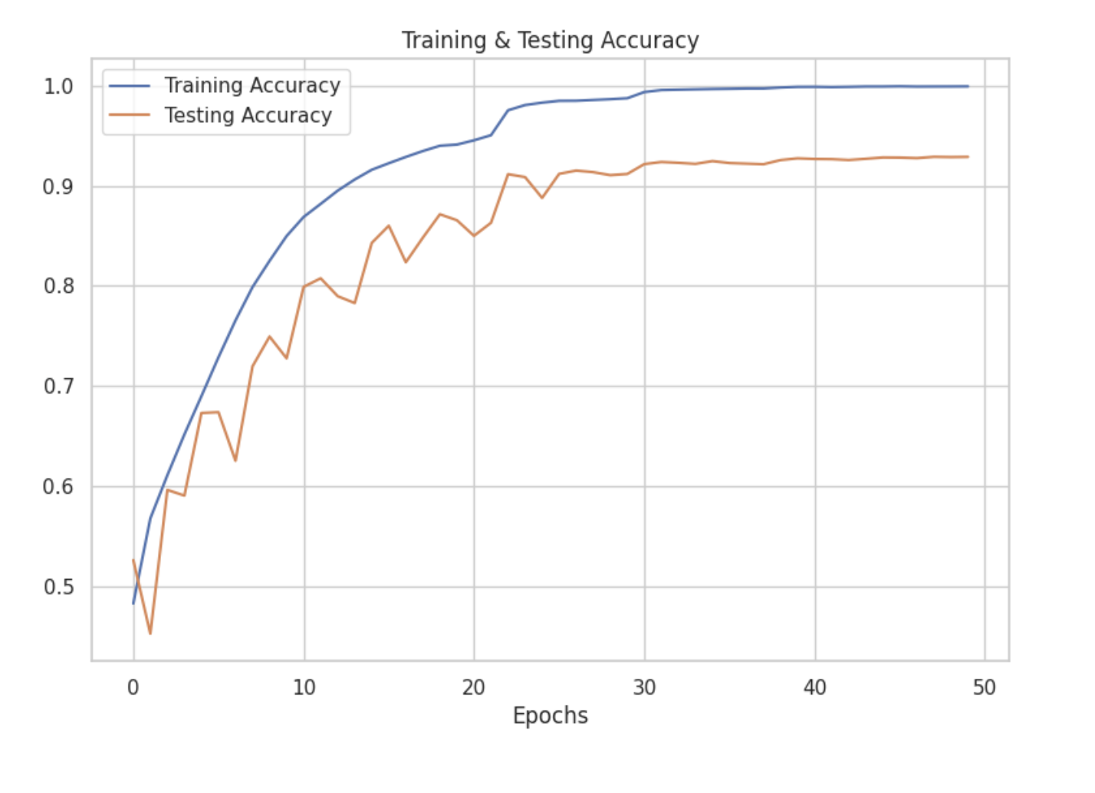
Model Building - 5 Layer

Slide 20
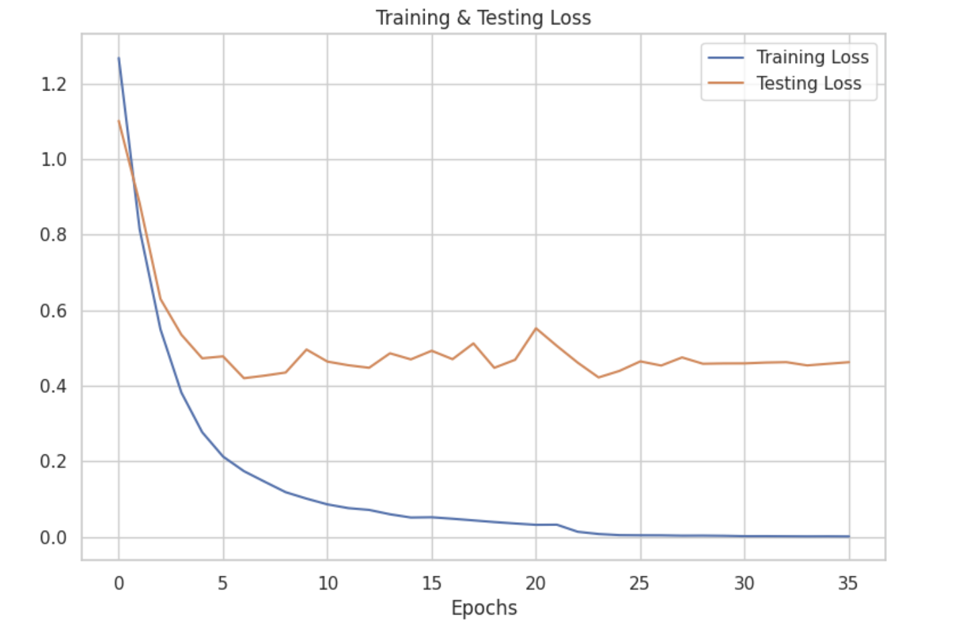
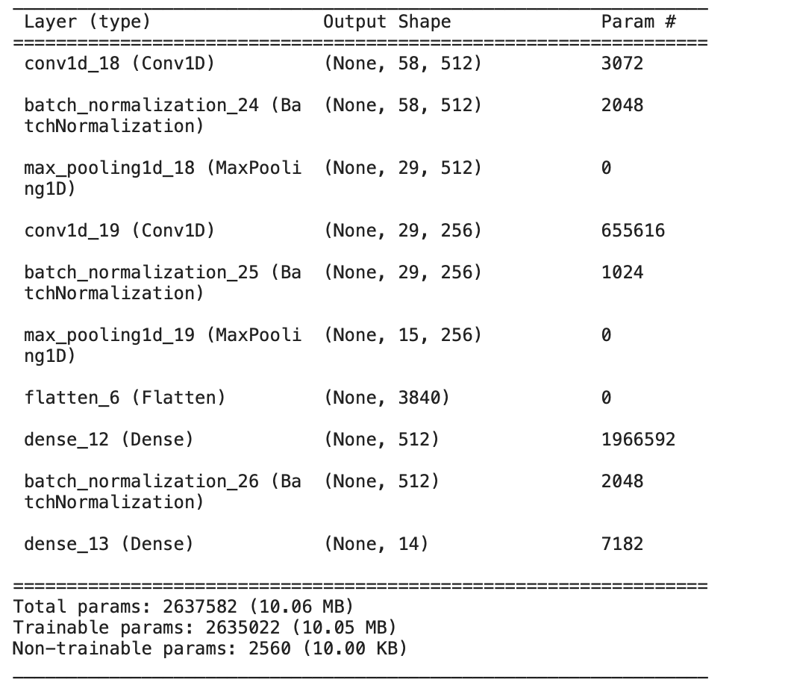
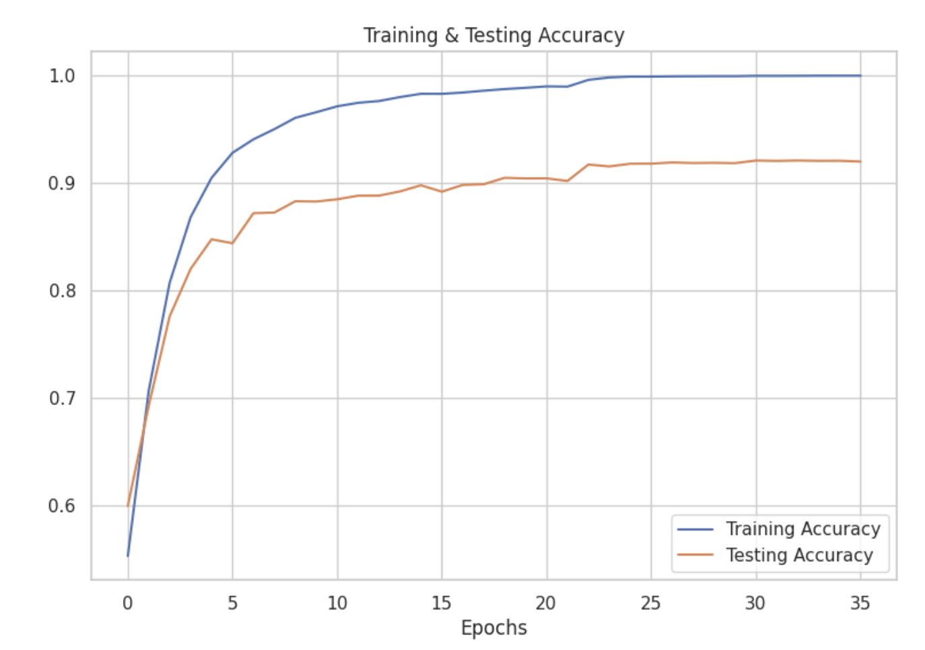
Model Building - 2 Scaled Layer

Slide 21
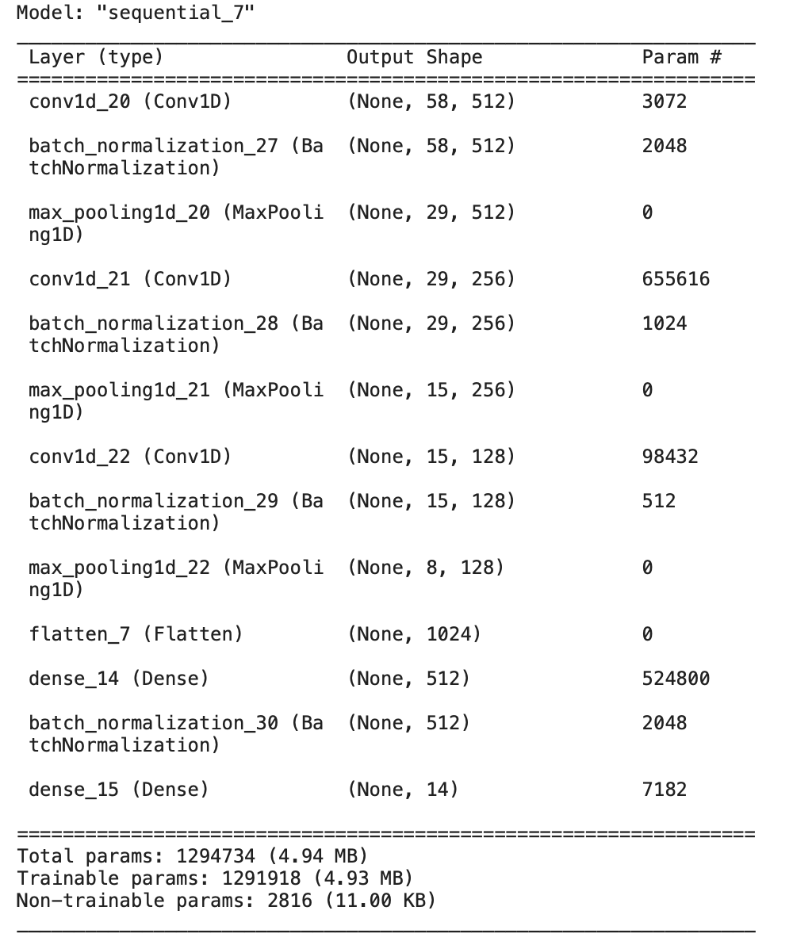
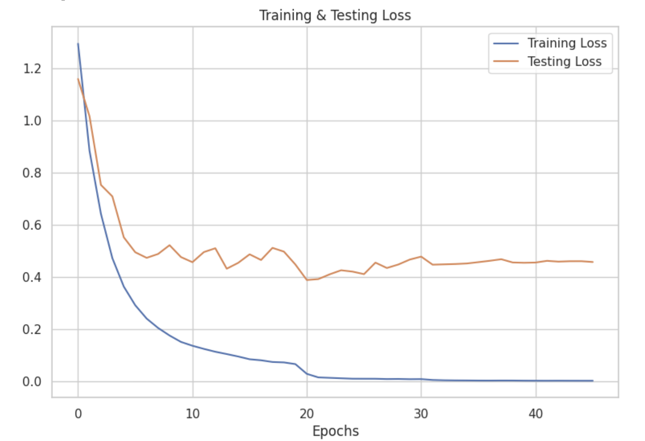
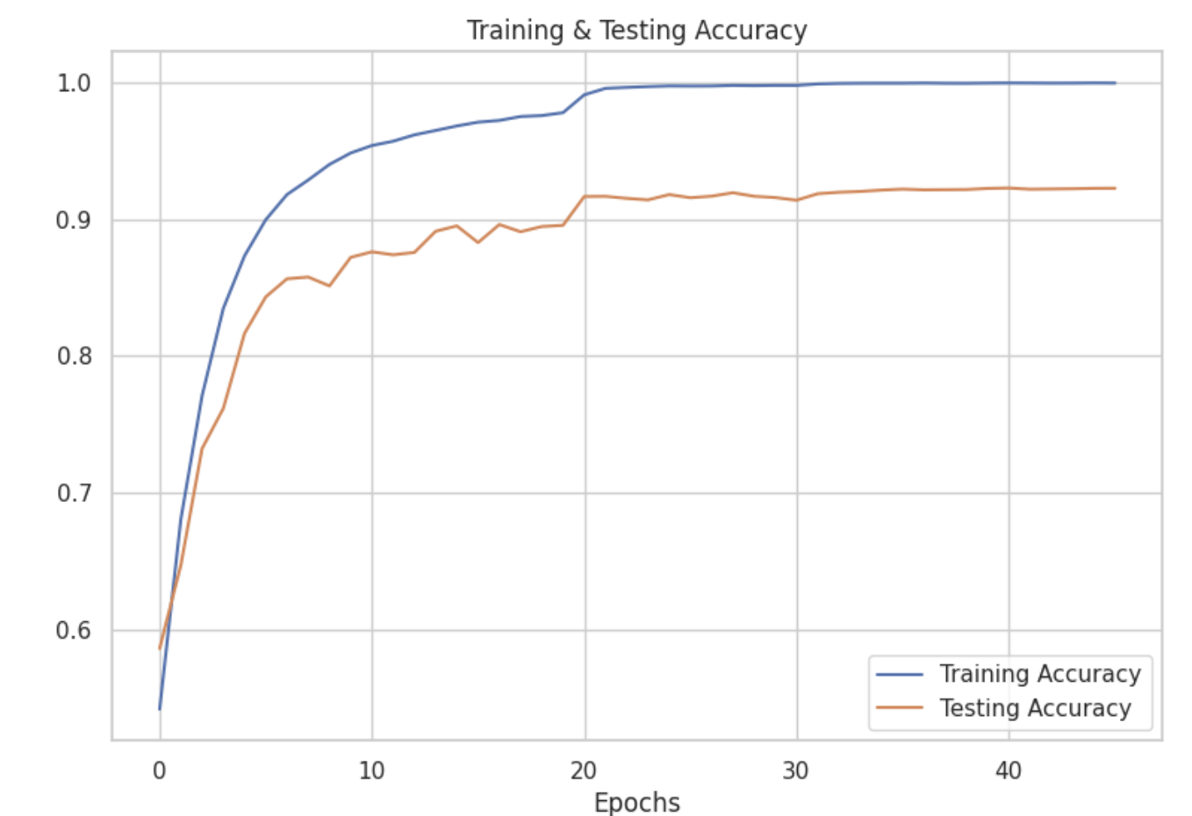
Model Building - 3 Scaled Layer

Slide 22
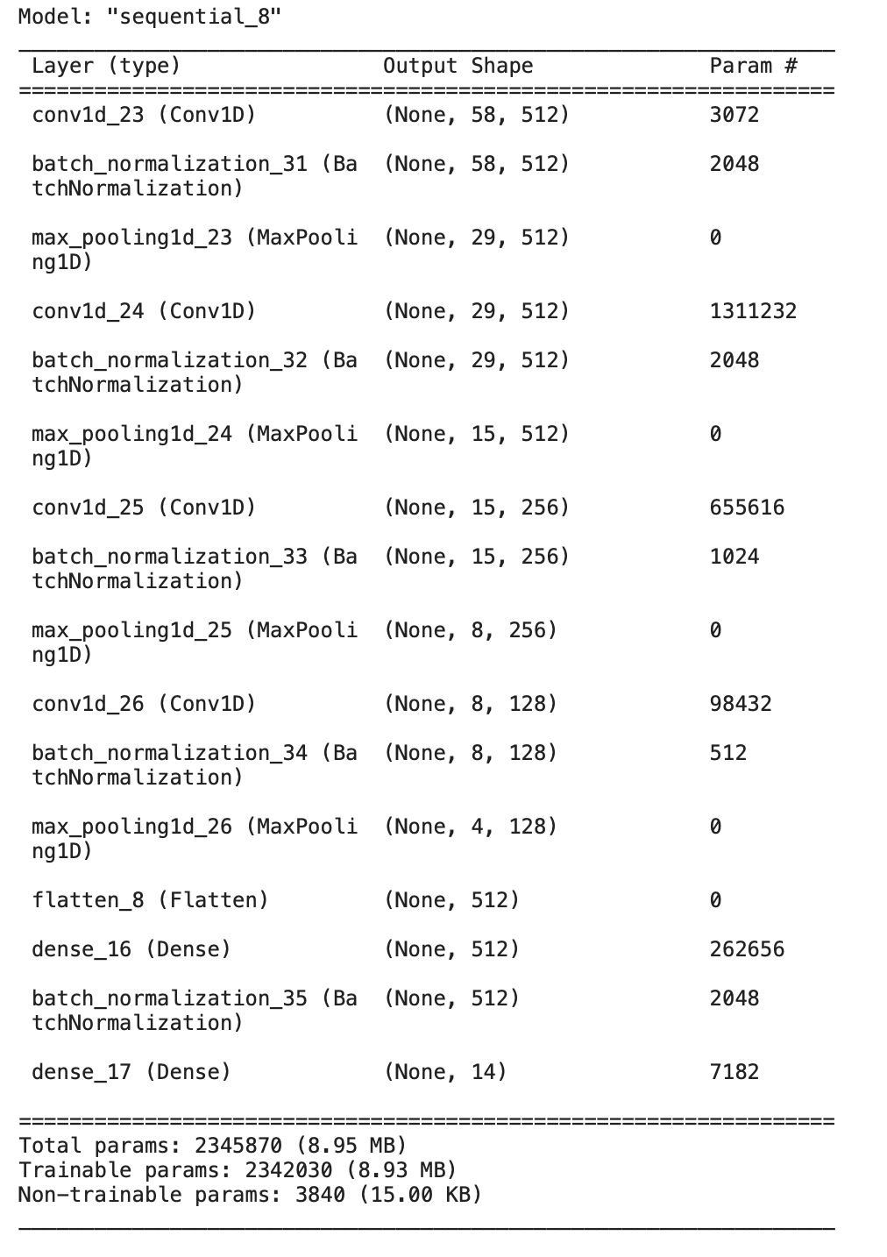
Model Building - 4 Scaled Layer

Slide 23
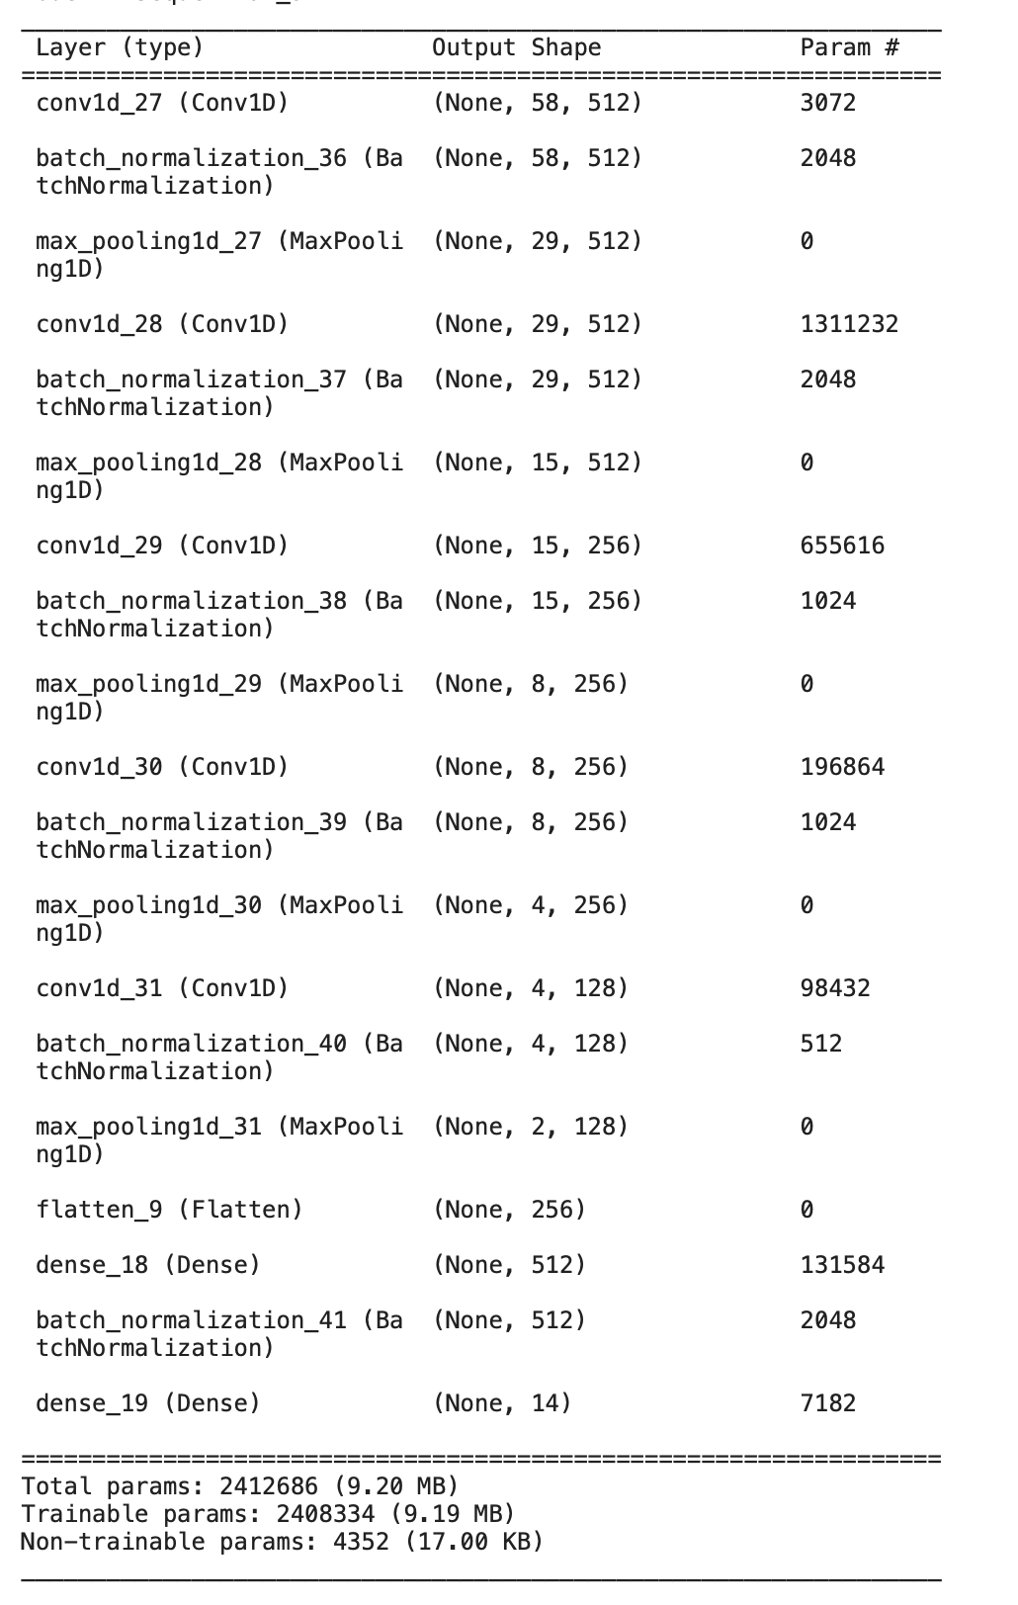
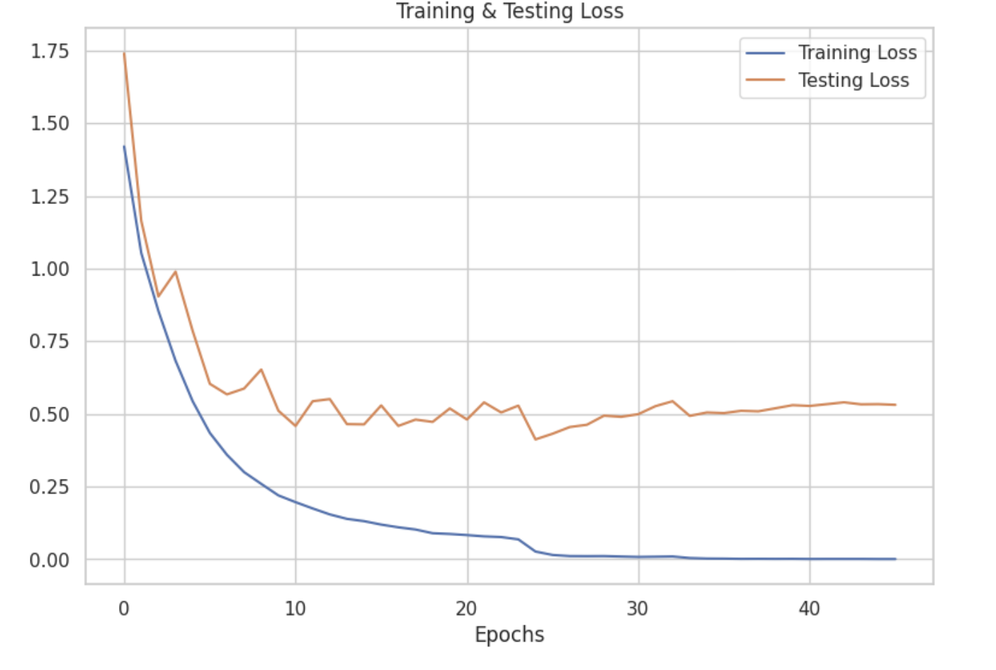
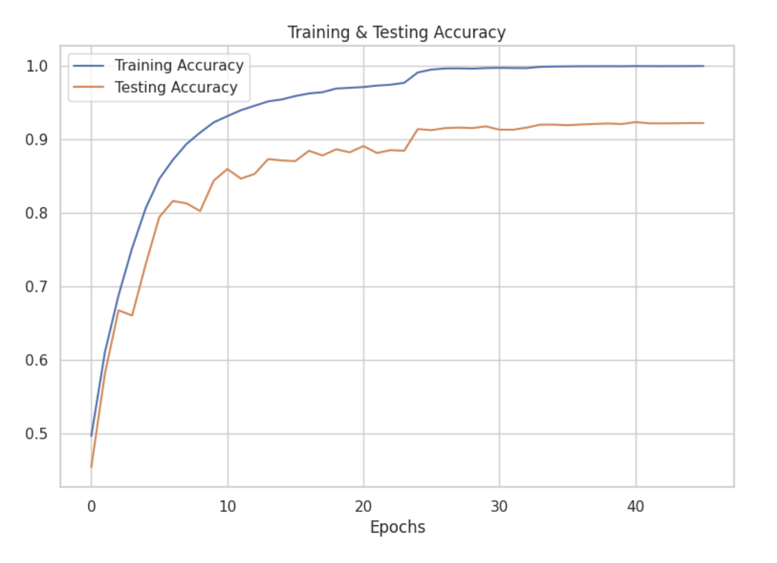
Model Building - 5 Scaled Layer

Slide 24
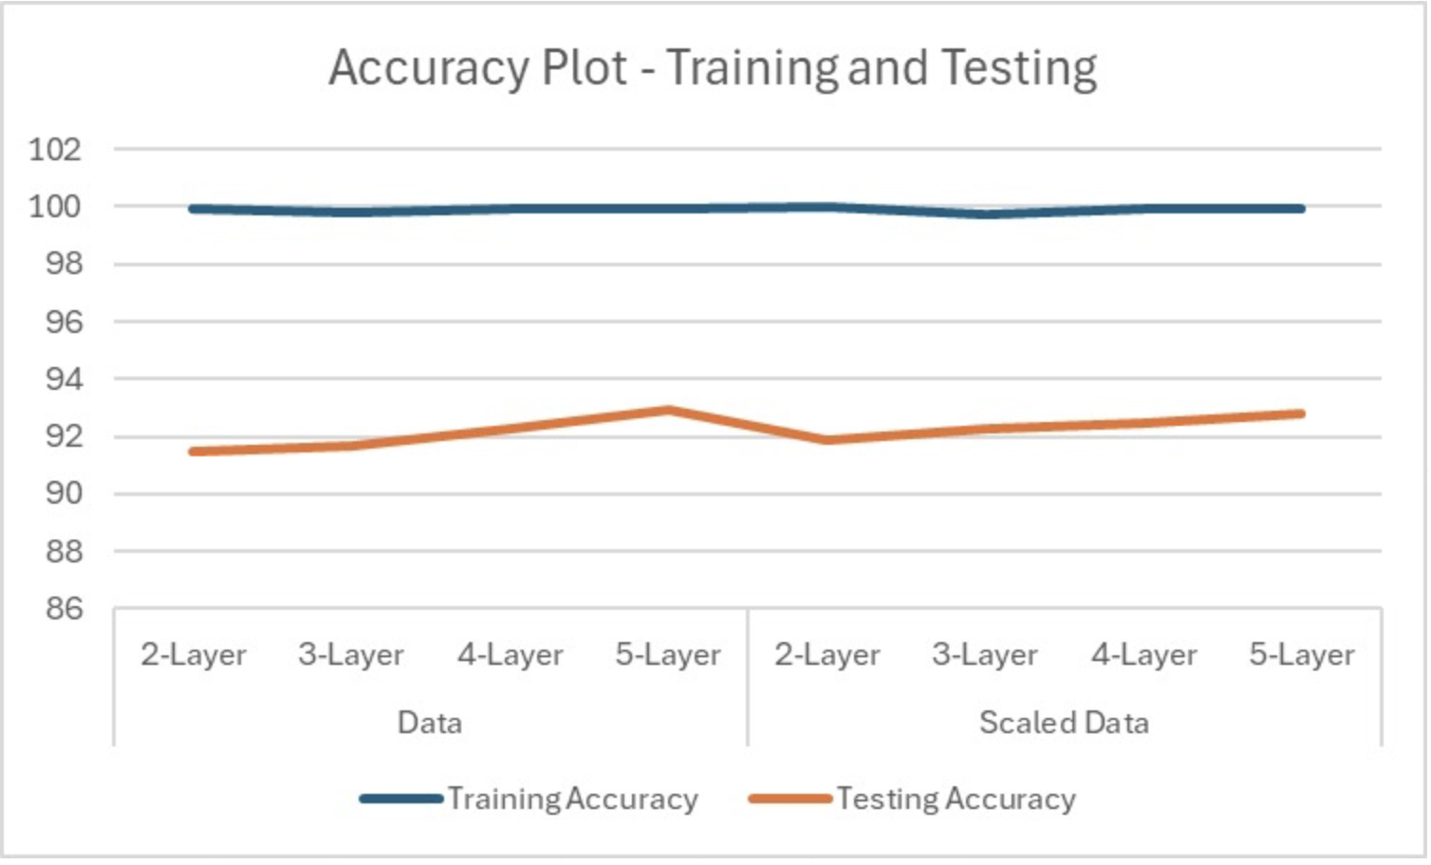
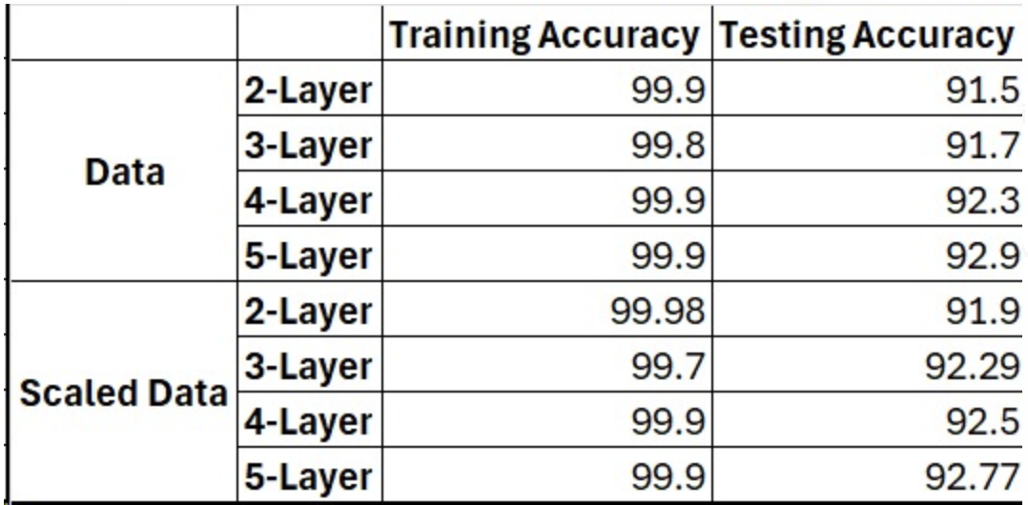
Validate and Select the model

Slide 25


Evaluating Model on Emotions

Slide 26


Evaluating Model on Gender

Slide 27
Conclusion
Developed CNN models on 4 different datasets, testing 2 to 5-layer architectures on original and scaled data.
- The 5-layer model on original data excelled with 99.9% training, 92.9% test accuracy.
Achieved emotion classification metrics (precision, recall, accuracy) exceeding 92%.
Obtained gender classification metrics (precision, recall, accuracy) surpassing 99%.

Slide 28
Thank you!

